Slide 1

FEVER WITH RASH

Slide 2
WHAT IS THAT?
FEVER
  temporary ↑ in the body’s temperature in response to some disease or illness
RASH
  temporary eruption of the skin
  discrete red spots / generalized reddening
  accompanied by itching

Slide 3
 In HISTORY TAKING :
Exposures
  Ill contacts (home, day care…)
  Travelling history
-Pets, insects
  Medications and drugs
  Immunization
Features of rash
- Temporal association (onset relative to fever)
Progression and evolution
Location and distribution
Pain or pruritus

Slide 4
 In PHYSICAL EXAMINATION :
Distribution pattern
  symmetrical eruption
  asymmetrical rashes
Morphology
  monomorphic
  pleomorphic
Configuration
  linear, annular, grouped,
  Koebner phenomenon (eruption in an area of local trauma)

Slide 5
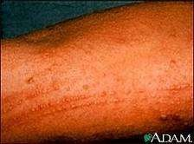
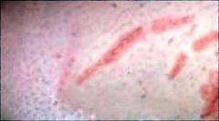
LINEAR RASH

Slide 6

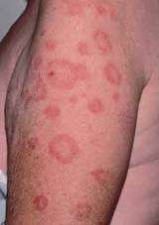
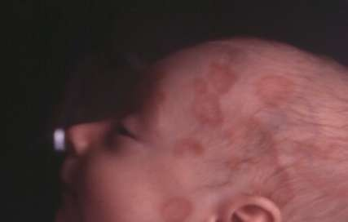
ANNULAR RASH

Slide 7
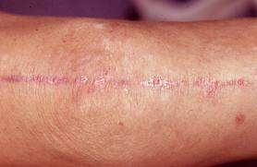
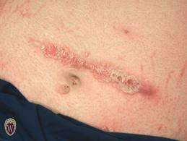
KOEBNER PHENOMENON

Slide 8
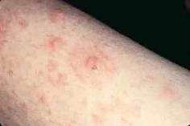
DIFFERENTIAL DIAGNOSIS OF FEVER WITH RASH
LESION | DESCRIPTION | PATHOGENS OR INFECTION
a) Maculopapular rash | macules – red/pink discrete flat areas, blanch on pressure papules – solid,raised hemispherical lesions, tiny, blanch on pressure | VRS - Measles, rubella, roseola, erythema infectiosum, EBV, echovirus, HBV, HIV BACT - Erythema marginatum, scarlet fever, erysipelas, 2° syphilis, leptospirosis, Lyme dzs, RICK – Rocky Mountain Spotted fever, Typhus
 |  | OTH – RA, Kawasaki dis, drug rxn

Slide 9
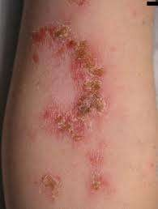
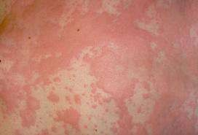
b) Diffuse erythroderma | - thickened, scaly skin on palms and soles | BACT - Scarlet fever, Toxic Shock Syndrome, Staph SSS FUNGI – Candida albicans OTH – Kawasaki syndrome
c) Urticarial rash | swelling of the lesions appear n resolve rapidly | VRS – EBV, Hep B, HIV BACT – M.pneumonia, Grp A strep. OTH – Drug rxn

Slide 10
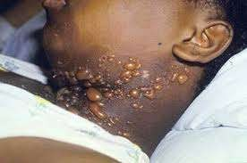
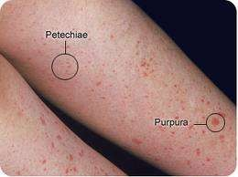
d) vesicular, pustular, bullous | -Vesicular – raised hemispherical lesions, < 0.5cm, contain clear fluid -Pustular, bullous – raised hemispherical lesion, >0.5cm, contain clear/purulent fluid | VRS - HSV, VZV, Coxsackievirus BACT - Staph.SSS, Staph. Bullous impetigo, Strep. crusted impetigo OTH - Toxic epidermal necrolysis, Steven- Johnson Syndrome. RICK – Rickettsial pox
e) Petechial - purpuric | - non-blanching red/purple spots | VRS - Atypical measles, congenital rubella, CMV, enterovirus, HIV, HF viruses
 |  | BACT - Sepsis (meningococcal, gonococcal, pneumococcal, Hib), IE

Slide 11
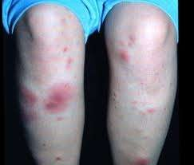
RICK – Rocky mountain spotted fvr
FUNGI – Aspergillus, mucor
OTH - Vasculitis, thrombocytopenia, Henoch-Schönlein purpura, malaria
f) Erythema Nodosum
- tender red nodules, due to exudation of blood and serum
VRS - EBV, HBV
BACT - Group A Streptococcus
TB, yersinia, Cat- Scratch Dzs
FUNGI -
Coccidiomycosis, histoplasmosis
OTH - Sarcoidosis, Inf. Bowel dzs, OCP, SLE, Behçet dzs

Slide 12
CASE SCENARIO
History:
9 mo old girl, good general health condition
Progressive fever for 5 days (max. 39.50C)
Coryza, exudative conjunctivitis
Severe cough and irritability
No diarrhea, no vomiting
No recent travel, no pets
 Rashes
over trunk, abdomen and back
appear 4 days after onset of fever
not elevated and no itching
blanching on pressure

Slide 13
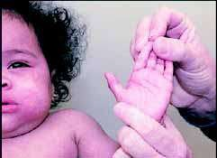
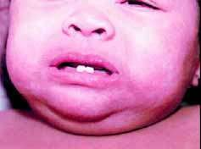
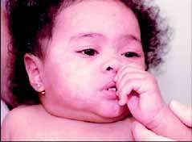
Confluent maculo-papular rash all over the body

Slide 14
MEASLES
Characteristic | EXPLAINATION
Causative Agent | Measles virus ( ssRNA paramyxovirus)
Host | Human
Invade | Upper respiratory tract, regional LN
Transmited by | Large respiratory droplets with no fomites (close contact transm.)
Virus present | Respiratory secretion, blood, urine
Period of communicability | Contagious from 5 days before to 4 days after the appearance of rash.

Slide 15
EPIDEMIOLOGY
Endemic in regions where measles vaccination is not available
Young infants - protected by transplacental antibody, but become more susceptible toward the end of the first year.
Passive immunity may interfere with effective vaccination until 12 to 15 months of age.

Slide 16
CLINICAL MANIFESTATION
 Divided into 4 phases :-
Incubation
  IP = 8 to 12 days from exposure to the onset of symptoms, 14 days from exposure to the onset of rash.
Prodromal (catarrhal)
  cough, coryza, conjunctivitis (Stimson line) Koplik spots (buccal mucosa)

Slide 17
Exanthematous (rash)
  accompanied by high grade fever (40-40.5°C)
  The rash starts behind the ears and on the forehead at the hair line spread down to the leg (descending)
  show severity of the illness
recovery

Slide 18
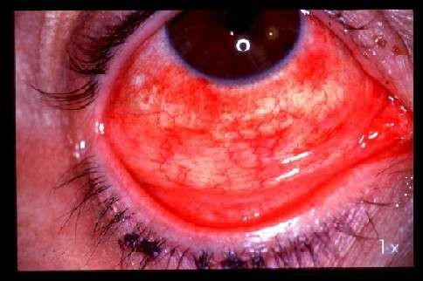
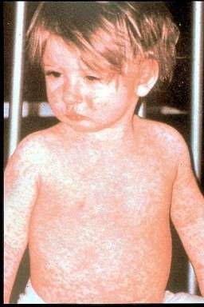
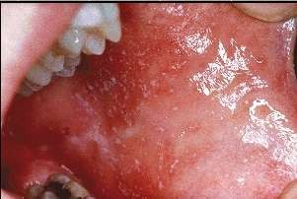
CONJUNCTIVITIS
KOPLIK SPOTS
MACULAR RASH

Slide 19
Other manifestations :
Cervical lymphadenitis
Spleenomegaly
Abdominal pain
Mesenteric lymphadenopathy
Otitis media
Pneumonia
Diarrhea
common in infants
 Liver involvement – common in adult

Slide 20
INVESTIGATIONS
Serological test
  IgM antibody
    appear in 1-2 days of rash
    persist for 1-2 month
Chest X-ray
  interstitial infiltration
  -ve measle pneumonia vs bacterial superinfection

Slide 21
DIAGNOSIS
Clinical
Serology
Viral culture
PCR

Slide 22
COMPLICATIONS
Acute otitis media (10-15%)
Interstitial pneumonia (50-75% pathological chest XR)
Myocarditis and pericarditis
Encephalitis (1/1000 cases) 7-10 days after rash
Subacute sclerosis panencephalitis
Mesenteric lymphadenitis

Slide 23
MANAGEMENT
TREATMENT
Routine supportive care
  maintain adequate hydration
  antipyretics
IV ribavirin (severe infection)
High dose for vitamin A supplementation

Slide 24
PREVENTION
 MMR
Live attenuated measles vaccine
  1st dose : 12-15 month of life
  2nd dose : 4-6 yrs old
* Contraindicated for severe immunosupression patient

Slide 25
RUBELLA
Characteristic | EXPLAINATION
Causative Agent | Rubella virus ( ssRNA, togavirus family)
Host | Human
Invade | Respiratory epithelium
Transmited by | Susceptible contact Infection in utero (congenital rubella synd) during the 1st trimester
Virus present | Nasopharyngeal secretion, urine
Period of communicabilit y | contagious from 2 days before until 5 to 7 days after the onset of rash

Slide 26
EPIDEMIOLOGY
Outbreak of rubella in nonvaccinated groups can occur in adults at their workplaces, prisons, colleges & healthcare centers
Transplacental antibody protection only during first 6 month of life

Slide 27
CLINICAL MANIFESTATION
 IP = 14 to 21 days
Retroauricular, posterior cervical, posterior occipital lymphadenopathy
Erythematous, maculopapular, discrete rashes
 Rashes - begins on the face, spreads down to the body and lasts far three days.

Slide 28
Forschheimer spots (rose-colored spots on the soft palate)
Mild pharyngitis
Conjunctivitis
Anorexia
Headache
Low grade fever
Polyarthritis

Slide 29
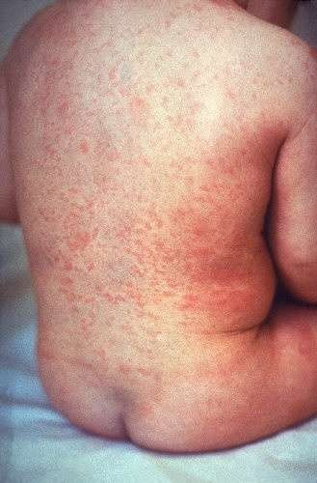
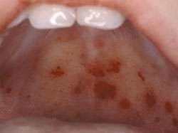
Erythematous maculopapular discrete rash
Forschheimer spots

Slide 30
INVESTIGATIONS
NON-SPECIFIC and do not aid in diagnosis
WBC – normal or low
Thrombocytopenia – rare
Serological test
  IgM antibody
  Fourfold rise in specific IgG antibodies in paired
acute & convalescent sera

Slide 31
COMPLICATIONS
Rarely complicated compared to measles
pregnancy – congenital rubella syndrome
  IUGR
  cataracts
  deafness
  patent ductus arteriosus (PDA)

Slide 32
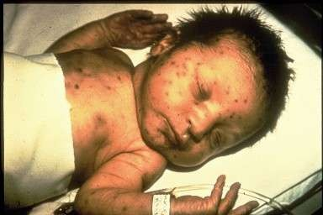
CONGENITAL RUBELLA SYNDROME

Slide 33
PRINCIPLE OF MANAGEMENT
TREATMENT
No specific therapy
Routine supportive care
Congenital Rubella Syndrome baby should be isolated

Slide 34
PREVENTION
 Live attenuated MMR vaccine
Children at age 12-15 months of life
Children at age 4-6 yrs old
Pregnant woman should be immunized after delivery

Slide 35
DIFFERENCES BETWEEN MEASLES AND RUBELLA
 | MEASLES | RUBELLA
RASH | Yes | Yes
FEVER | Yes | Mild or no fever
CHARACTERISTIC | Confluent macular rash, Koplik spots | Maculopapular discrete rash, Forschheimer spots
TRANSMISSION | Droplet, airborne | Droplet
SYMPTOMS | High fever, runny nose, cough and for 3-5 days, followed by rash | Rash with minimal to no fever or toxicity; infection possible without rash

Slide 36
SPREAD OF RASH | Starts on head and upper body Spreads slowly down to feet over 7 days | Starts on head and upper body Spreads quickly down to feet over 3 days
COMPLICATION | Viral or bacterial pneumonia, encephalitis, otitis media, blindness | Congenital infection
SEVERITY | Moderate to severe | Mild

Slide 37

Varicella (chickenpox)

Slide 38
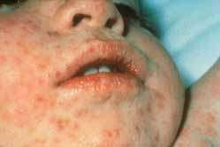
History: 5 y old boy, no special past medical history
Low grade fever (38.30C) for 48 h
Clinical case
Attends school
No travel history
No pets
Vesicular rash on the trunk and face

Slide 39
Varicella (chickenpox)
Causes: Varicella zoster virus (VZV, herpesvirus family)
Human are the only natural host
Chickenpox (vericella) = manifestation of primary infection
Highly contagious among susceptible individuals; secondary attack rate is more than 90%)
Contagiosity: 2 days before to 7 days after the onset of the rash, when all lesions are crusted

Slide 40
Peak age: 5 to 10 years old
Peak seasonal infection: late winter and spring
Transmission: direct contact, droplet, and air
Incubation period: 14-16 days

Slide 41
Clinical manifestation
Prodromal symptoms: fever, malaise, anorexia (preceed the rash by 1 day)
Characteristic rash: small red papules> Erythematous papules> vesicular> vesicles ulcerate, crust and heal (new crops appear for 3- 4 days)
Pattern of rash: beginning on the trunk followed by the head, face, and less commonly the extremities
Pruritus is universal and marked
Lesions may also present on mucosa membranes
Lymphadenopathy may be generalized

Slide 42
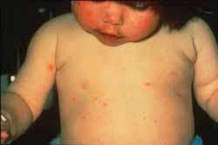
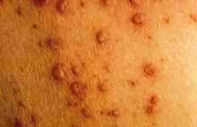
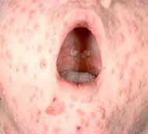
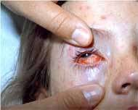

Slide 43
Complication
Common
More severe for neonates, adults, and
immunocompromised persons.
Secondary infection of skin by streptococci pr staphylococci
Thrombocytopenia and haemorragic lesions or bleeding
may occur (varicella gangrenosa)
Pneumonia (15-20% 0f healty adults and immunlcompromised persons, uncommon in healthy children)
Myocarditis, pericarditis, orchitis, hepatitis, ulcerative gastritis, glomerulonephritis and athritis may complicate
Reye syndrome may follow varicella (aspirin use is contraindicated)
Neurological complication: post infectious enencephaly, cerebellar ataxia, nystagmus and tremor.

Slide 44
Congenital infection
-characteristic: low birth weight, cortical atrophy, seizure, mental retardation, chorioretinitis, cataracts,microcephaly
Perinatal infection
-severe form of noenatal varicella

Slide 45
Treatment
Symptomatic therapy: Nonaspirin antipyretics, cool baths, careful hygiene
Antiviral treatment: acyclovir, famciclovir, valacyclovir

Slide 46
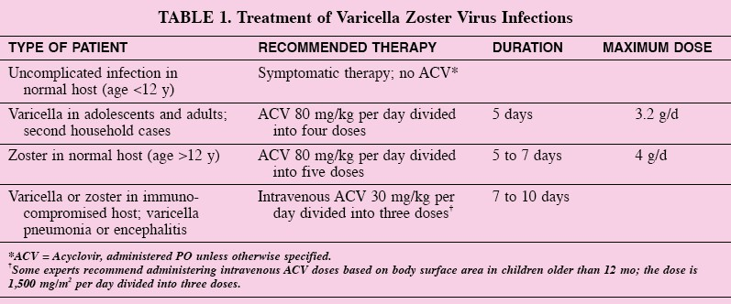

Slide 47
Prevention
Children with chickenpox should not return to school until all vesicle have crusted
Live attenuated varicella (primary prevention)
Passive immunity by VZIG (secondary prevention)

Slide 48
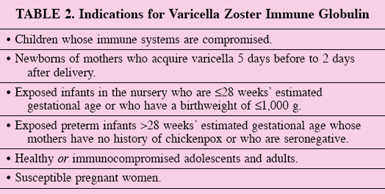
 Must be administered by 96h after exposure (or better if < 72h)

Slide 49

Hand,foot and mouth disease

Slide 50
Hand,foot and mouth disease
most often occurs in children under 10 years old.
Causes: coxsackie virus A16, enterovirus 71 (EV71) and other enteroviruses.
The enterovirus group includes polioviruses, coxsackieviruses, echoviruses and other enteroviruses.
more frequent in summer and early autumn (in temperate countries)

Slide 51
moderately contagious.
A person is most contagious during the first week of the illness.
transmitted from person to person via direct contact with nose and throat discharges, saliva, fluid from blisters, or the stool of infected persons.
(incubation period) is 3 to 7 days. Fever is often the first symptom of HFMD followed by blister/rash.

Slide 52
Clinical manifestation
mild fever,
poor appetite,
malaise ("feeling sick"), and
frequently a sore throat.
One or 2 days after the fever begins, painful sores develop in the mouth. They begin as small red spots that blister and then often become ulcers.
They are usually located on the tongue, gums, and inside of the cheeks.
The skin rash develops over 1 to 2 days with flat or raised red spots, some with blisters on the palms of the hand and the soles of the feet.

Slide 53
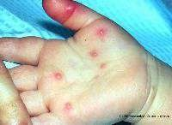
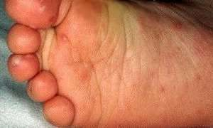
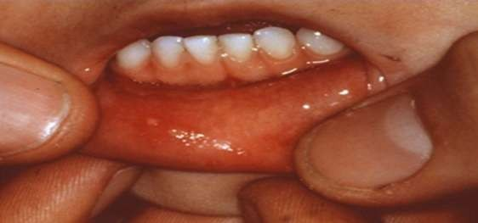
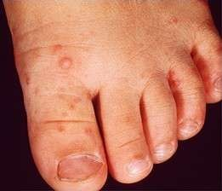
Blister on the soles of the feet
Blister on the palms of the hands
Blister then become ulcer on the inner gums
Blister on the dorsum of the feet

Slide 54
Complication
HFMD caused by coxsackie virus A16 infection is a mild disease and nearly all patients recover within 7 to 10 days.
Complications are uncommon.
HFMD caused by Enterovirus EV71 may be associated with neurological complications such as aseptic meningitis and encephalitis

Slide 55
Treatment
no specific effective antiviral drugs and vaccine available for the treatment of HFMD.
Symptomatic treatment is given to provide relief from fever, aches, or pain from the mouth ulcers.
Dehydration is a concern because the mouth sores may make it difficult and painful for children to eat and drink.

Slide 56
Prevention
good hygienic practices. Preventive measures include:
a. Frequent hand washing, especially after diaper changes, after using toilet and before preparing food,
b. Maintain cleanliness of house, child care center, kindergartens or schools and its surrounding,
c. Cleaning of contaminated surfaces and soiled items with soap and water, and then disinfecting them with diluted solution of chlorine-containing bleach (10% concentration),
d. Parents are advised not to bring young children to crowded public places such as shopping centers, cinemas, swimming pools, markets or bus stations,
e. Bring children to the nearest clinic if they show signs and symptoms. Refrain from sending them to child care centers, kindergartens or schools.
f. Avoidance of close contact (kissing, hugging, sharing utensils, etc.) with children having HFMD illness to reduce of the risk of infection

Slide 57



Slide 58
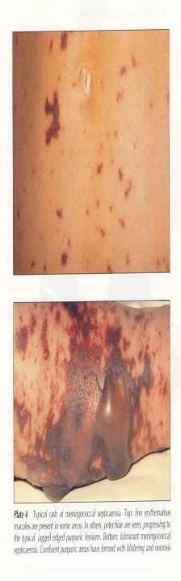
caused by Neisseria meningitidis (meningococcus)
transmission: person-to-person by respiratory droplets
 colonization of URT → penetrate into bloodstream
→ go to CNS and causing meningitis
(meningococcal meningitis) / infect the blood
vessel (meningococcemia)
Meningococcemia / meningococcal septicaemia:
cutaneous signs:
  Maculopapular – early, often on a painful joint or pressure point
  Petechiae (50-70%) – distribute at trunk and extremities (can be anywhere else)
  Purpura (may start anywhere on the body and
then spread) and necrotic area
.
Non-cutaneous signs: altered mental status, neck

Slide 59
Meningococcal septicemia can kill children in hours, therefore optimal outcome requires immediate recognition, prompt resuscitation and antibiotics.
Although there are now polysaccharide conjugate vaccines against groups A and C meningococcus, there is still no effective vaccines for group B meningococcus

Slide 60
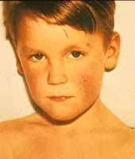
CLINICAL CASE
History: 7 y. old boy, good general health condition
Sudden onset of sore throat since 24hrs and fever at 39oC. Abdominal pain and
1 episode of vomiting
No conjuntivitis,
No rhinitis,
No hoarseness
No cough
Attends primary school, no recent travel

Slide 61
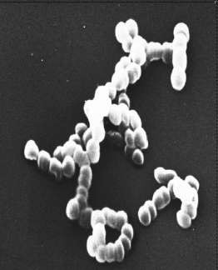
Scarlet Fever
caused by group A streptococcus (GAS)
transmission: direct contact through droplets
symptoms:
  rashes:
    develop 24 hours after the fever
    can begins at below ears , neck, chest and stomach then spread all over the body within 1 to 2 days
    look like sunburn and feel like sandpaper
    more apparent at skin fold of elbow, armpit and groin area
    last for about 2-7 days
    as the rash faded, skin at the tips of lips and fingers begin to peel
flush face
fever >38.3°C
swollen glands at the neck
white or yellow spot coating on the throat and tonsil
“strawberry tongue”

Slide 62
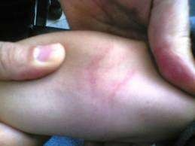
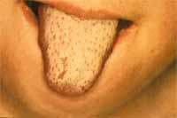
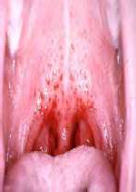
In body folds, especially the armpits and elbows, fragile blood vessels (capillaries) can rupture and cause classic red streaks called Pastia lines. These may persist for 1-2 days after the generalised rash has gone.

Slide 63
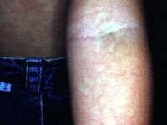
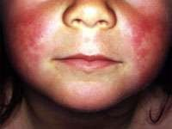
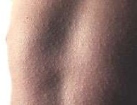
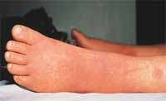

Slide 64
 Diagnosis:
Throat culture remains the criterion standard for confirmation of group A streptococcal upper respiratory infection.
Complete blood count
  White blood cell (WBC) count in scarlet fever may increase to 12,000-16,000 per mm³, with a differential of up to 95% polymorphonuclear lymphocytes.
  During the second week, eosinophilia, as high as 20%, can develop.
 Treatment : Penicillin remains the drug of choice. Erythromycin can be considered as an alternative

Slide 65
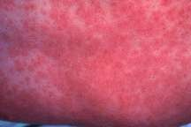
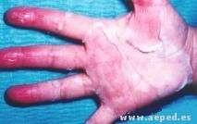
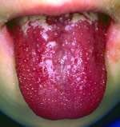
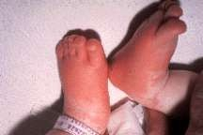
KAWASAKI DISEASE
characterized by fever at least for 5 days together with 4 of the following 5 findings:
  conjungtival infection
  mucous membrane changes (pharyngeal red, dry,
cracied lips, strawberry tongue)
  cervical lymphadenopathy
  rash
  redness or swelling of the hands and feet, generalized skin peeling
age: 4 month – 6 years
cause is unknown
complication: coronary artery aneurysm, sudden death

Slide 66
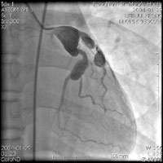
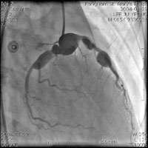
Complications
Coronary artery aneurysm
Prognosis
75% no sequelae, 25% coronary abnormality (without treatment),
1-2% mortality in the acute phase

Slide 67
TYPHUS
A general name for various arthropod-borne rickettsial infections and that result in an acute febrile illness.
A Rickettsia- harboring louse bites a human to engage in a blood meal and causes a pruritic reaction on the host's skin. The louse defecates as it eats; when the host scratches the site, the lice are crushed, and the Rickettsia- laden excrement is inoculated into the bite wound. The Rickettsia travel to the bloodstream and rickettsemia develops.

Slide 68
Symptoms of Typhus
Severe headache
Chills
High fever
Stupor
Muscle aches
Swollen lymph nodes
Skin rash - macular, maculopapular, petechial or papulovesicular eruption
Forearm skin rash spreading to the body

Slide 69
Diagnostic Tests
The list of diagnostic tests mentioned in various sources as used in the diagnosis of Typhus includes:
Blood tests for rickettsiae
Antibody blood tests (IgM, IgG)- Indirect Immunofluorescent Assay (IFA), rise indicate acute primary or secondary disease
Tests depend on the type of typhus
Treatment
Specific antimicrobial therapy effective against rickettsia should be used. Doxycycline and chloramphenicol are used as antirickettsial agents for the treatment of typhus.

Slide 70
INFECTIOUS MONONUCLEOSIS
Caused by Epstein-Barr virus (EBV)
Has particular tropism for B lymphocytes and epithelial cells of the pharynx
Transmission usually occurs by oral contact

Slide 71
Signs and symptoms
Fever
Malaise
Tonsillopharygitis – often severe, limiting oral ingestion of fluids and food, rarely breathing can be compromised
Lymphadenopathy – prominent cervical lymph nodes
Petechiae on the soft palate
Splenomegaly (50%), hepatomegaly (10%)
Maculopapular rash (5%)

Slide 72
DIAGNOSIS
Patients with infectious mononucleosis in the differential diagnoses should have a CBC count with differential and an evaluation of the erythrocyte sedimentation rate (ESR)
Because the liver is uniformly involved in EBV infectious mononucleosis, mild elevation of the serum transaminases is a constant finding in early EBV infectious mononucleosis.
Heterophile antibody tests
 Patients with infectious mononucleosis should first be tested with a heterophile antibody test. The most commonly used is the latex agglutination assay using horse RBCs, and it

Slide 73
TREATMENT
Medical Care
Closely monitor patients with extreme tonsillar enlargement for airway obstruction. Steroids are indicated for impending or established airway obstruction in individuals with Epstein-Barr virus (EBV) infectious mononucleosis.
Surgical Care
Surgery is necessary for spontaneous splenic rupture, which occurs in rare patients with EBV infectious mononucleosis and may be the initial manifestation of the condition.

Slide 74
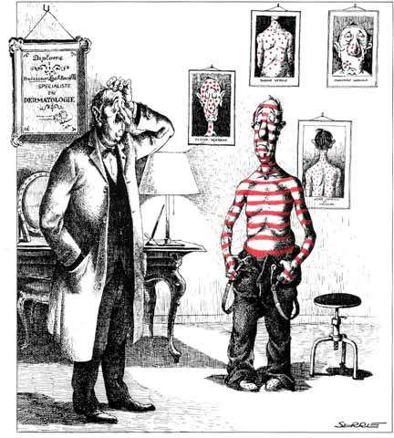
THANK YOU

