Slide 1
PULMONARY TUBERCULOSIS
INTRODUCTION PATHOLOGY&PATHOGENESIS
DR.P.YUGANDHAR
PROFESSOR
DEPT. OF PULMONOLOGY

Slide 2
INTRODUCTION
Tuberculosis (TB) is an ancient disease with a history interwoven with the evolution and migration of mankind, as well as with the origins of microbiology. The main etiologic agent of TB, Mycobacterium tuberculosis (Mtb), is thought to have evolved from an early progenitor in East Africa as early as 3 million years ago.By the early 1800s, TB epidemics ravaged much of Europe and North America, resulting in 800 to 1000 deaths per 100 000 per year.
Today, approximately 9 million new cases of TB are identified per year, with almost 2 million deaths related to TB, making Mtb the single greatest cause of mortality due to a bacterial pathogen.

Slide 3
INTRODUCTION
Mtb is a major component of the history of microbiology. In 1882, Robert Koch demonstrated the tubercle bacillus during a presentation of his famous postulates, which have since set the standard for the demonstration of infectious etiology. Koch also developed tuberculin, a glycerine extract of pure Mtb cultures, which, although a failure in its proposed use as a therapy, could be used to detect latent infections by the measurement of skin reactions at the injection site.

Slide 4

Global TB Burden -2017
 | Global | India
Incidence | 1,04,00,000 (140/lakh) | 27,90,000 (211/lakh)
Deaths | 16,74,000 (22/lakh) | 4,35,000 (33/lakh)
HIV TB cases | 10,30,000 (14/lakh) | 87,000 (6.6/lakh)
HIV TB deaths | 3,74,000 (5.0/lakh) | 12,000 (0.9/lakh)
Estimated MDR/RR cases | 6,01,000 (8.1/lakh population) | 1,47,000 (11/ lakh population)

Slide 6
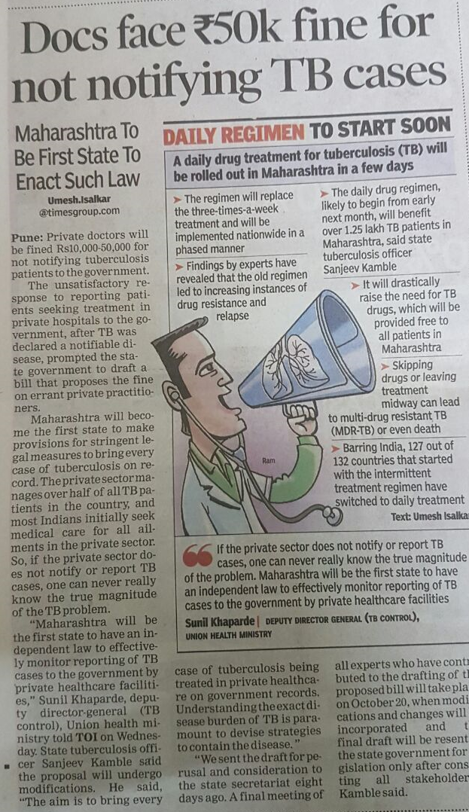
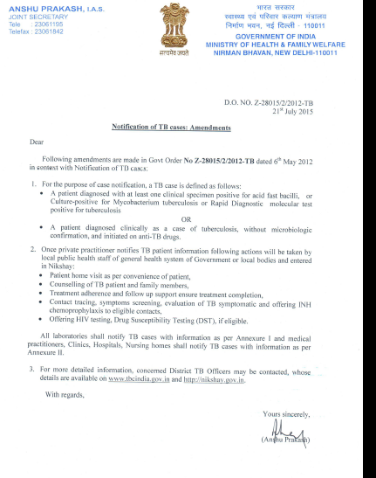
Bold Policies

Slide 7
INDIAN SCENARIO
INDIA FALLS IN THE HIGH BURDEN COUNTRIES,WHICH ARE 22 COUNTRIES THAT ACCOUNT FOR 80% OF THE NEW TB CASES ARISING ANNUALLY.
THESE COUNTRIES INCLUDE INDIA ,CHINA ,BRAZIL ,RUSSIA,SOUTH AFRICA,PAKISTAN,BANGLADESH,BESIDES OTHERS.
NEARLY 50% OF THE WORLD’S TB POPULATION LIVE IN INDIA ,CHINA,INDONESIA , BANGLADESH AND PAKISTAN.
TOTAL TB DEATHS IN 2006 WERE 1.7 MILLION, OUT OF WHICH INDIA ACCOUNTS FOR NEARLY FOR 30%.

Slide 8

History of TB (1)
TB has affected humans for millennia
Historically known by a variety of names, including:
  Consumption
  Wasting disease
  White plague
TB was a death sentence for many
Vintage image circa 1919
Image credit: National Library of Medicine

Slide 9
DISCOVERY OF M.tb
A major breakthrough in the fight against TB occurred when Calmette and Guérin developed the attenuated vaccine strain, Bacille Calmette-Guérin (BCG), through multiple passages of Mycobacterium bovis on ox bile and glycerol-soaked potato slices between 1906 and 1919.
Although highly effective in preventing the childhood form of TB, the BCG vaccine has variable efficacy in adults. As an attenuated strain, BCG has been enormously useful in TB research because, unlike Mtb, BCG does not require biosafety level 3 facilities.

Slide 10
Today, the absence of a completely protective TB vaccine, the slow development of new antimycobacterial drugs, the need for prolonged therapy regimens, and the emergence of multidrug-resistant (MDR) and extremely drug-resistant (XDR) strains of Mtb are issues that highlight the reemerging TB crisis. The MDR strains account for almost 5% of TB cases.

Slide 11
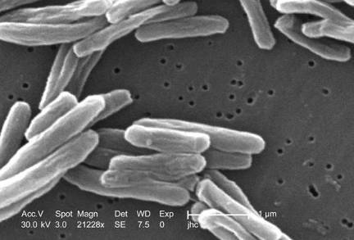
History of TB (2)
Scientific Discoveries in 1800s
Until mid-1800s, many believed TB was hereditary
1865 Jean Antoine-Villemin proved TB was contagious
1882 Robert Koch discovered M. tuberculosis, the bacterium that causes TB
Mycobacterium tuberculosis
Image credit: Janice Haney Carr

Slide 12
THE BACTERIUM
Mycobacteria are nonmotile, nonsporulating, weakly gram-positive, acid-fast bacilli that appear microscopically as straight or slightly curved rods, 1 to 4 μm in length and 0.3 to 0.6 μm wide.
Mycobacteria are within the order Actinomycetales, which it shares with bacteria such as Corynebacterium, Nocardia, and Rhodococcus. These bacteria also express unique mycolic acids in the cell envelope that play a critical role in the structure and function of the cell wall.

Slide 13
The waxy cell wall confers many of the unique characteristics of this genus: acid-fastness, extreme hydrophobicity, resistance to drying, acidity/alkalinity, and many antibiotics, as well as distinctive immunostimulatory properties.

Slide 14
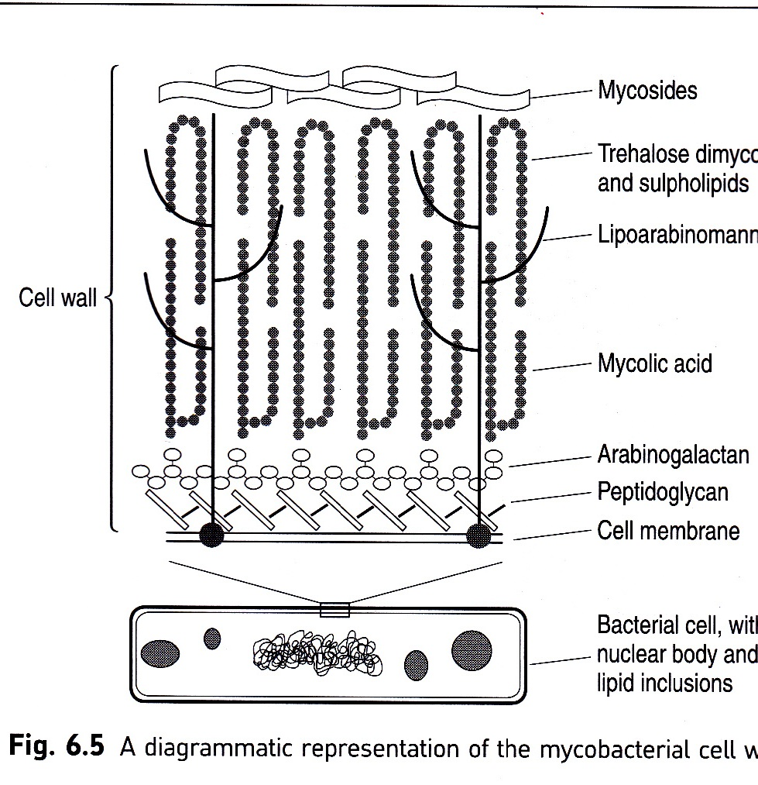
M.Tb CELL WALL

Slide 15
THE M.tb FAMILY
Mtb is a member of the slow-growing pathogenic mycobacterial species, characterized by a 12- to 24-hour division rate and prolonged culture period on agar of up to 21 days.
Why Mtb grows so slowly is not well understood. Proposed mechanisms include limitation of nutrient uptake through the highly impermeable cell wall and slow rates of RNA synthesis.

Slide 16
During experimental infections, its metabolism can shift from an aerobic, carbohydrate-metabolizing mode to one that is microaerophilic and lipid metabolizing.
Mycobacteria are facultative intracellular bacteria that multiply within phagocytic cells, particularly macrophages and monocytes. Although many mycobacterial species are environmental, Mtb is strictly parasitic.

Slide 17
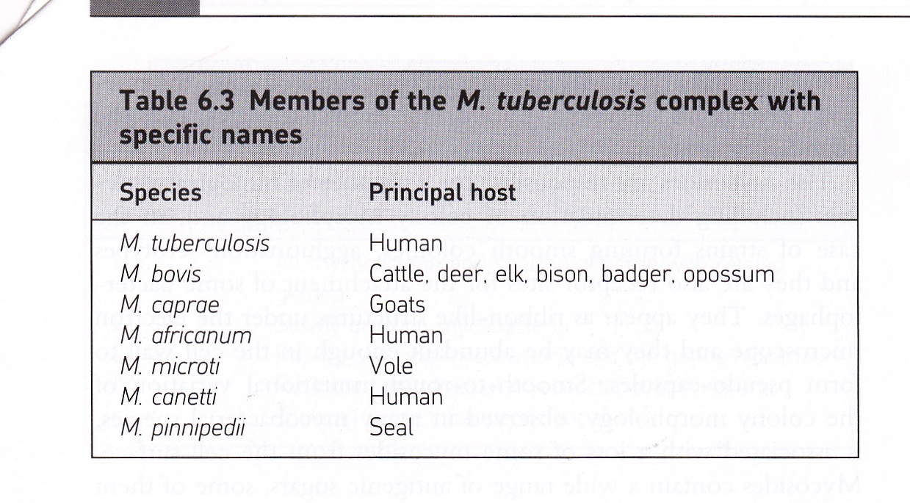

Slide 18
Mtb is a member of the M. tuberculosis complex, which is defined as the etiologic agents of TB in distinct hosts, and also includes M. bovis, M. africanum, M. canetti, and M. microti, with M. caprae and M. pinnipedii considered variants of M. bovis. It was previously assumed that Mtb evolved from M. bovis during the domestication of cattle, a theory made widespread by the national bestseller, Guns, Germs, and Steel.

Slide 19
The genome sequencing projects for both species, however, revealed that M. bovis has several DNA deletions while maintaining 99.95% identity with Mtb and no new genetic material, supporting the opposite scenario.
Successive DNA deletions of regions of difference (RD) resulted in the branching off of members of the Mtb complex.
These genetic analyses indicate that members of the Mtb complex are the clonal progeny of an ancestral strain of M. canetti, also referred to as Mycobacterium prototuberculosis.

Slide 20
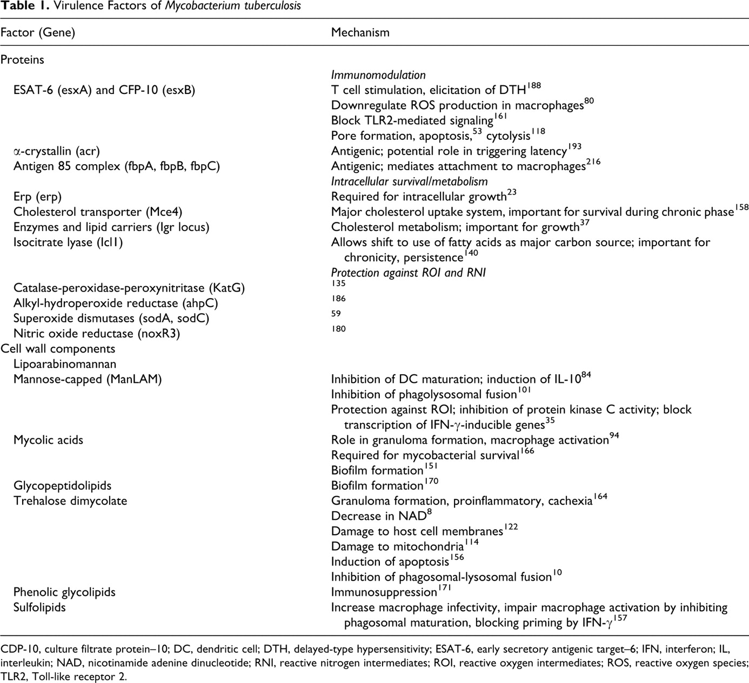

Table 1. Virulence Factors of Mycobacterium tuberculosis .
Sakamoto K Vet Pathol 2012;49:423-439
Copyright © by American College of Veterinary Pathologists
Notes:
Virulence Factors of Mycobacterium tuberculosis

Slide 21
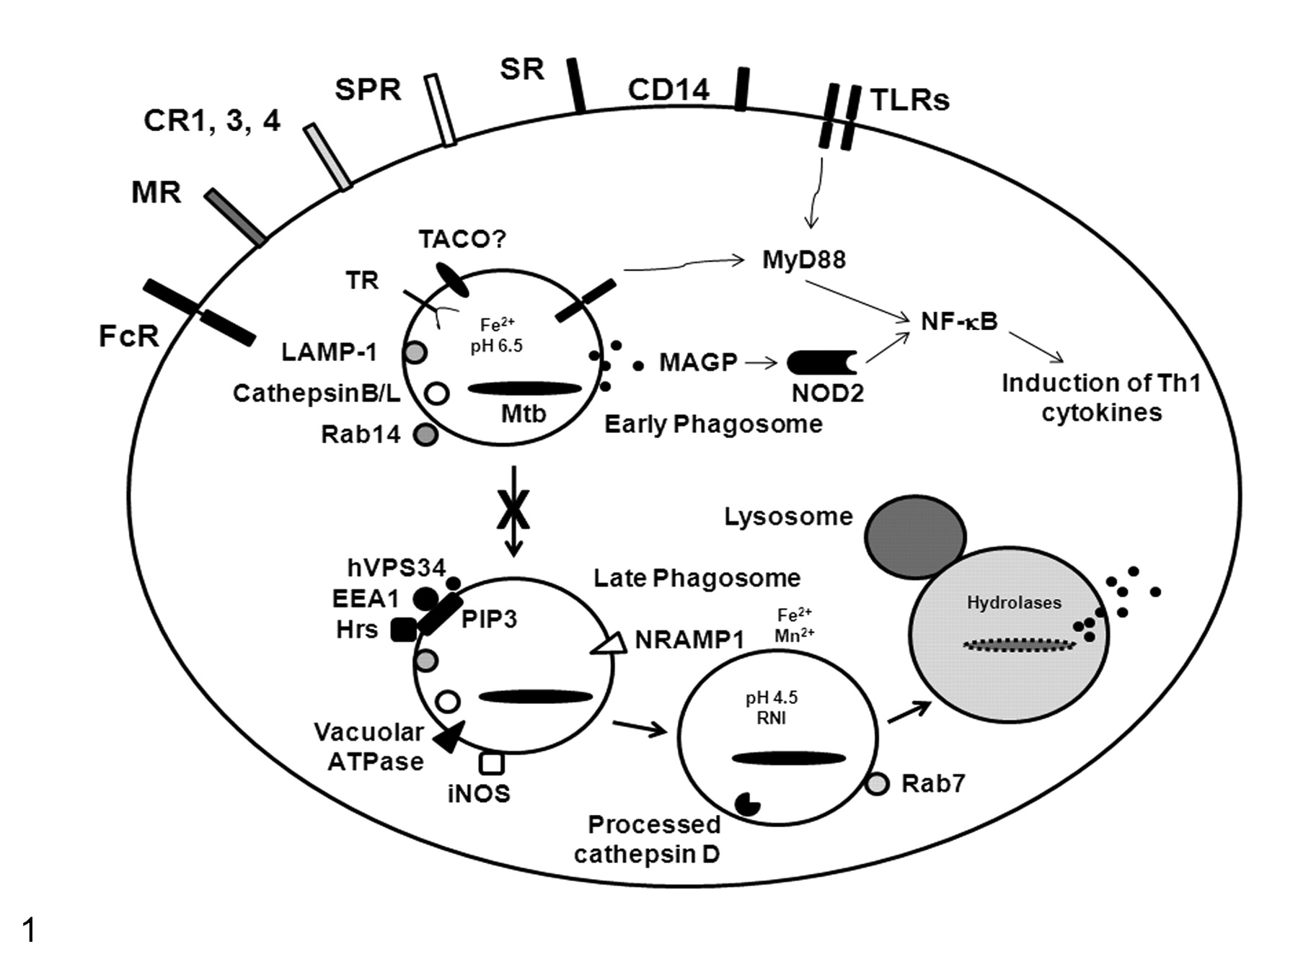
Figure 1. Cell biology of Mycobacterium tuberculosis (Mtb) infection.
Sakamoto K Vet Pathol 2012;49:423-439
Copyright © by American College of Veterinary Pathologists
Notes:
Cell biology of Mycobacterium tuberculosis (Mtb) infection. Mtb interacts with macrophages through a number of receptors that have been shown in vitro to differentially regulate the fate of the bacillus. Phagocytic receptors include the Fc receptor (FcR), mannose receptor (MR), complement receptors (CR1, CR3, CR4), surfactant protein receptors (SPR), and scavenger receptors (SR). CD14 is a tethering receptor that aids in Toll-like receptor (TLR) signaling. TLRs are expressed at both the plasma and phagosomal membranes and induce cytokine production via the MyD88 signaling pathway. Mycolylarabinogalactan-peptidoglycan (MAGP) from the Mtb cell wall can be released into the cytoplasm, where it is detected by the pattern recognition receptor, NOD2/CARD15. Both TLR and NOD2 signaling induce cytokine gene transcription via nuclear factor–κB (NF-κB). Once in the phagosome, live Mtb blocks phagosomal maturation (X). The mycobacterial phagosome actively retains the characteristics of an early endosome, such as tryptophan aspartate coat protein (TACO), although this is currently in debate. ⁶⁵ Vacuolar proton ATPase, inducible nitric oxide synthase (iNOS), and natural resistance-associated membrane protein 1 (NRAMP1) are inhibited from associating with this phagosome, thereby avoiding pH reduction, reactive nitrogen intermediates (RNIs), and Fe²⁺/Mn²⁺ starvation, respectively. ^{74,146,195} Phosphatidylinositol 3-phosphate (PI3P), a lipid involved in proper trafficking of lysosomal constituents to phagosomes, is also continuously eliminated from phagosomes containing live Mtb due to the hydrolytic activity of secreted lipid phosphatase, SapM. ²¹¹ Early endosomal autoantigen 1 (EEA1) and Hrs, both of which are trafficking molecules that associate with PI3P, are also prevented from associating with the Mtb phagosome. ^{75,215} The Mtb cell wall component, lipoarabinomannan (LAM), potentially prevents phagosomal maturation through transient inhibition of cytoplasmic Ca²⁺ fluxes, which then impairs recruitment of the kinase (hVPS34) that produces PI3P. ²¹⁰ TR, transferrin receptor; LAMP-1, lysosomal-associated membrane protein-1; Rab, small GTPases. Modified from Kaufmann. ¹¹⁵

Slide 22
TB Transmission
Transmission is defined as the spread of an organism, such as M. tuberculosis, from one person to another.

Slide 23
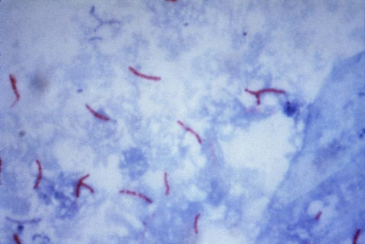
TB Transmission
Types of Mycobacteria
M. tuberculosis causes most TB cases in the world
Mycobacteria that cause TB:
  M. tuberculosis
  M. bovis
  M. africanum
  M. microti
  M. canetti
Mycobacteria that do not cause TB
  e.g., M. avium complex
M. tuberculosis

Slide 24
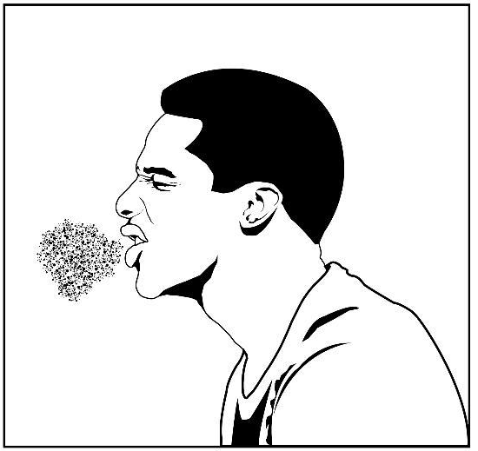
TB Transmission
TB is spread person to person through the air via droplet nuclei
M. tuberculosis may be expelled when an infectious person:
  Coughs
  Sneezes
  Speaks
  Sings
Transmission occurs when another person inhales droplet nuclei

Slide 25
TB Transmission
Probability that TB will be transmitted depends on:
  Infectiousness of person with TB disease
  Environment in which exposure occurred
  Length of exposure
  Virulence (strength) of the tubercle bacilli
The best way to stop transmission is to:
  Isolate infectious persons
  Provide effective treatment to infectious persons as soon as possible

Slide 26
TB Transmission
The probability that TB will be transmitted depends on what four factors?
    Infectiousness of person with TB disease
    Environment in which exposure occurred
    Length of exposure
    Virulence (strength) of tubercle bacilli

Slide 27
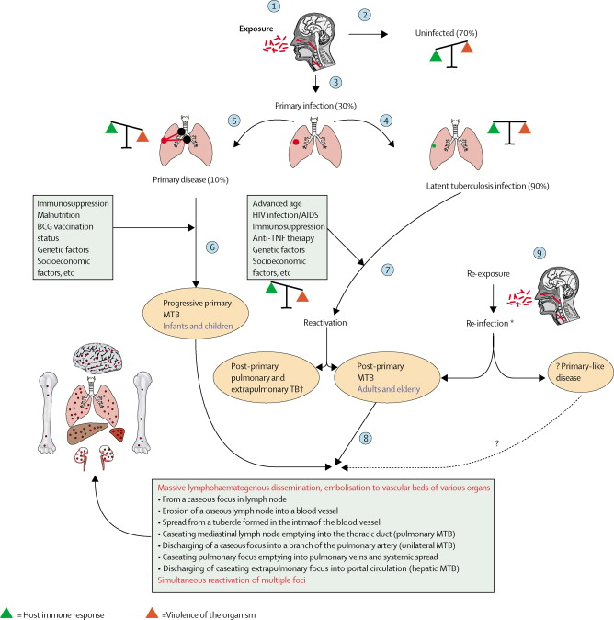

Slide 28
TB Transmission
What organism causes most TB disease ?
M. tuberculosis
What are 4 other mycobacteria that cause TB
disease?
  M. bovis, M. africanum, M. microti, and M.
  canetti

Slide 29
TB Transmission
How is TB spread?
  TB is spread from person to person through the air via droplet nuclei containing M. tuberculosis.

Slide 30
TB Transmission
The probability that TB will be transmitted depends on what four factors?
    Infectiousness of person with TB disease
    Environment in which exposure occurred
    Length of exposure
    Virulence (strength) of tubercle bacilli

Slide 31
TB Pathogenesis
Latent TB Infection (LTBI)
Occurs when tubercle bacilli are in the body, but the immune system is keeping them under control
Detected by the Mantoux tuberculin skin test (TST) or by blood tests such as interferon-gamma release assays (IGRAs) which include:
  QuantiFERON®-TB Gold test (QFT-G)
  QuantiFERON®-TB Gold In-Tube (QFT-GIT)
  T-Spot®.TB test (T-SPOT)
People with LTBI are NOT infectious

Slide 32
TB Pathogenesis
TB Disease
Develops when immune system cannot keep tubercle bacilli under control
  May develop very soon after infection or many years after infection
About 10% of all people with normal immune systems who have LTBI will develop TB disease at some point in their lives
People with TB disease are often infectious

Slide 33
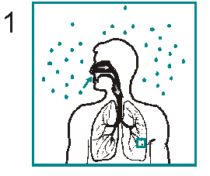
TB Pathogenesis
Droplet nuclei containing tubercle bacilli are inhaled, enter the lungs, and travel to small air sacs (alveoli)

Slide 34
TB Pathogenesis
Tubercle bacilli multiply in alveoli, where
infection begins

Slide 35
TB Pathogenesis
A small number of tubercle bacilli enter bloodstream and spread throughout body

Slide 36
TB Pathogenesis
LTBI
Within 2 to 8 weeks the immune system produces special immune cells called macrophages that surround the tubercle bacilli
These cells form a barrier shell that keeps the bacilli contained and under control (LTBI)

Slide 37
TB Pathogenesis
TB Disease
If the immune system CANNOT keep tubercle bacilli under control, bacilli begin to multiply rapidly and cause TB disease
This process can occur in different places in the body

Slide 38
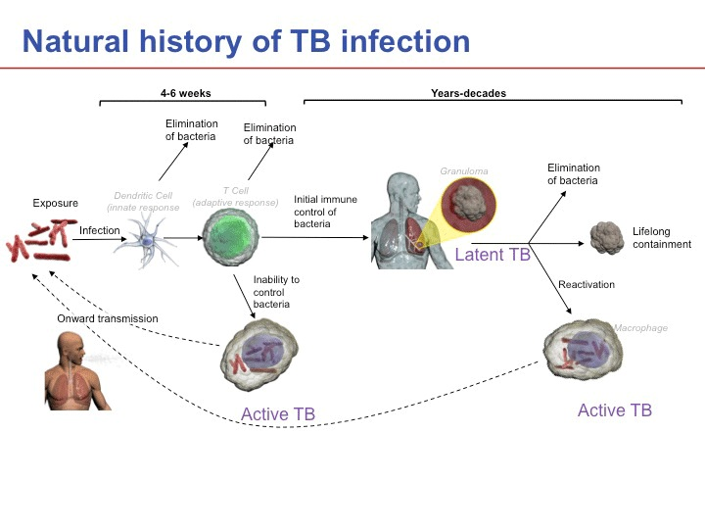

Slide 39
LTBI vs. TB Disease
Latent TB Infection (LTBI) | TB Disease (in the lungs)
Inactive, contained tubercle bacilli in the body | Active, multiplying tubercle bacilli in the body
TST or blood test results usually positive | TST or blood test results usually positive
Chest x-ray usually normal | Chest x-ray usually abnormal
Sputum smears and cultures negative | Sputum smears and cultures may be positive
No symptoms | Symptoms such as cough, fever, weight loss
Not infectious | Often infectious before treatment
Not a case of TB | A case of TB

Slide 40
TB Pathogenesis
When a person inhales air that contains droplet nuclei containing M. tuberculosis, where do the droplet nuclei go?
  Most of the larger droplet nuclei become lodged in the upper respiratory tract, where infection is unlikely to develop
  However, droplet nuclei may reach the small air sacs of the lung (the alveoli), where infection begins

Slide 41
TB Pathogenesis
After the tubercle bacilli reach the small air sacs of the lung (the alveoli), what happens to them?
    Tubercle bacilli multiply in alveoli and some enter the bloodstream and spread throughout the body
    Bacilli may reach any part of the body
    Within 2 to 8 weeks, the immune system usually intervenes, halting multiplication and preventing further spread

Slide 42
TB Pathogenesis
In people with LTBI (but not TB disease), how does the immune system keep the tubercle bacilli under control?
The immune system produces special immune cells that surround the tubercle bacilli. These cells form a shell that keeps the bacilli contained and under control.

Slide 43
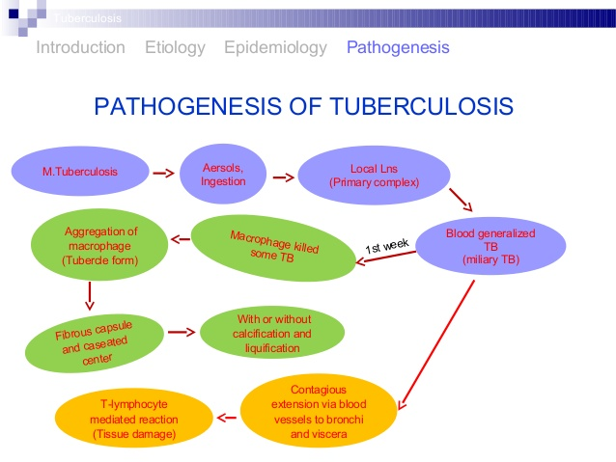

Slide 44
TB Pathogenesis
How is LTBI detected? (pg. 16)
LTBI is detected by the Mantoux tuberculin skin test (TST) or blood tests such as interferon-gamma release assays (IGRA), which include the QuantiFERON®-TB test (QFT-G), QuantiFERON®-TB Gold In-tube (QFT-GIT), or T-SPOT.

Slide 45
TB Pathogenesis
What happens if the immune system cannot keep the tubercle bacilli under control and the bacilli begin to multiply rapidly?
When this happens, TB disease develops. The risk that TB disease will develop is higher for some people than for others.

Slide 46
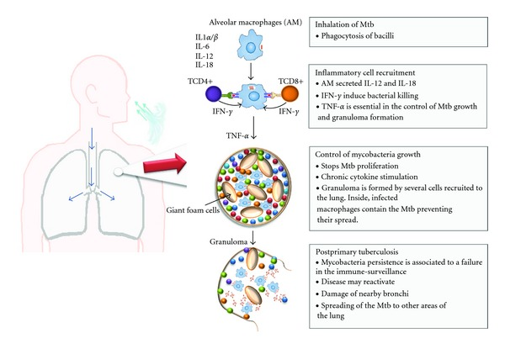

Slide 47
CLASSIFICATION OF TB DISEASE
BASED ON THE SEQUENCE OF EVENTS FOLLOWING FIRST EXPOSURE:
PRIMARY TUBERCULOSIS:
IS DUE TO THE FIRST CONTACT OFTB BACILLUS WITH A PERSON- MORE COMMON IN CHILDREN IN INDIA AND OTHER ENDEMIC COUNTIRIES.
PATHOLOGICAL HALLMARK- GHON’S FOCUS AND GHON COMPLEX IN THE LUNG.
PROGRESSIVE PRIMARY TB:
IS DUE PROGRESSION OF PRIMARY FOCUS INTO TB DISEASE –HAPPENS IN USUALLY IMMUNOCOMROMISED INDIVIDUALS.

Slide 48
POST PRIMARY TB:
IS DUE TO EITHER ENDOGENOUS REACTIVATION OR EXOGENOUS REINFECTION.
SEEN MOST COMMONLY IN ADULTS IN ENDEMIC COUNTRIES.
BASED ON THE SITE OF INFECTION
LOCALISED- PULMONARY OR EXTRA PULMONARY
DISSEMINATED: WHEN TWO OR MORE NON-CONTIGUOS ORGANS ARE INVOLVED.

Slide 49
Progression to TB Disease (1)
Risk of developing TB disease is highest the first 2 years after infection
People with LTBI can be given treatment to prevent them from developing TB disease
Detecting TB infection early and providing treatment helps prevent new cases of TB disease

Slide 50
Progression to TB Disease (2)
Some conditions increase probability of LTBI progressing to TB disease
Infection with HIV
Chest x-ray findings suggestive of previous TB
Substance abuse
Recent TB infection
Prolonged therapy with corticosteroids and other immunosuppressive therapy, such as prednisone and tumor necrosis factor-alpha [TNF-α] antagonists
Organ transplant
Silicosis
Diabetes mellitus
Severe kidney disease
Certain types of cancer
Certain intestinal conditions
Low body weight

Slide 51
Progression to TB Disease (3)
People Exposed to TB
Not
TB Infected
Latent TB Infection (LTBI)
Not
Infectious
Not
Infectious
Negative TST or QFT-G test result
Positive TST or QFT-G test result
May go on to develop TB disease
No
TB Infection
Latent TB Infection
Figure 1.5

Slide 52

Progression to TB Disease (4)
TB and HIV
In an HIV-infected person,
TB can develop in one of
two ways:
Person with LTBI becomes infected with HIV and then develops TB disease as the immune system is weakened
Person with HIV infection becomes infected with M. tuberculosis and then rapidly develops TB disease
Image credit: Mississippi State Department of Health

Slide 53
Sites of TB Disease (1)
Bacilli may reach any part of the body, but common sites include:

Slide 54
Sites of TB Disease (2)
 | Location | Frequency
Pulmonary TB | Lungs | Most TB cases are pulmonary
Extrapulmonary TB | Places other than lungs such as: Larynx Lymph nodes Pleura Brain Kidneys Bones and joints | Found more often in: HIV-infected or other immunosuppressed persons Young children
Miliary TB | Carried to all parts of body, through bloodstream | Rare

Slide 55
Sites for TB
What part of the body is the most common
site for TB disease?
  Lungs are the most common site
What are some other sites?
- Larynx
- Lymph nodes
- Pleura (membrane around the lungs)
- Brain
- Kidneys
- Bones and joints

Slide 56
WHAT IS A GRANULOMA?
GRANULOMA IS THE PATHOLOGICAL HALLMARK OF TUBERCULOSIS WHICH IS USUALLY CALLED EPITHELOID NECROTISING CONFLUENT TYPE.
THIS CONSISTS OF CENTRAL NECROTIC AREA SURROUNDED BY EPITHELOID CELLS,LANGHANS GIANT CELLS,LYMPHOCYTES AND FIBRROBLASTS.

Slide 57
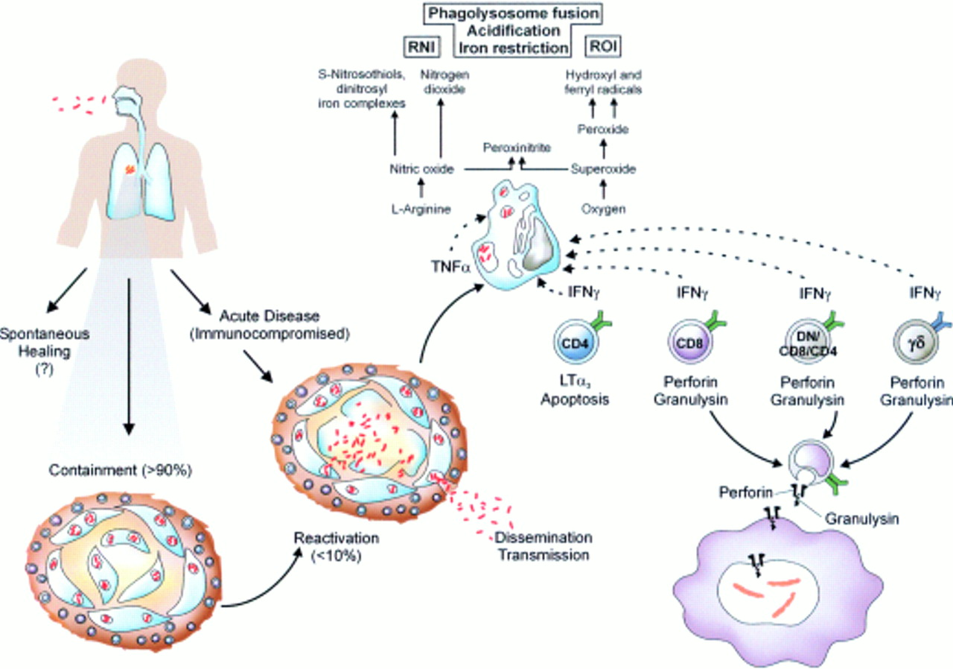

Slide 58
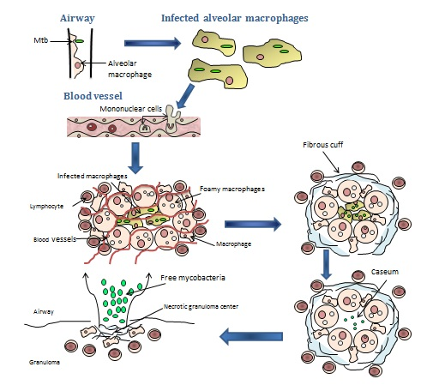
GRANULOMA FORMATION

Slide 59
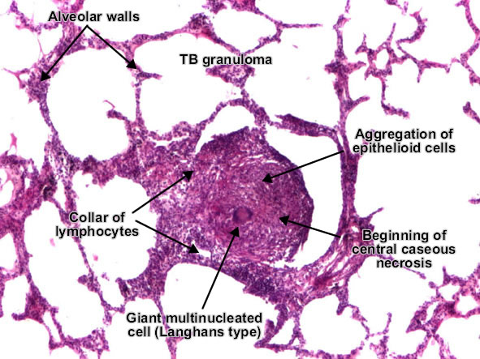
GRANULOMA

Slide 60
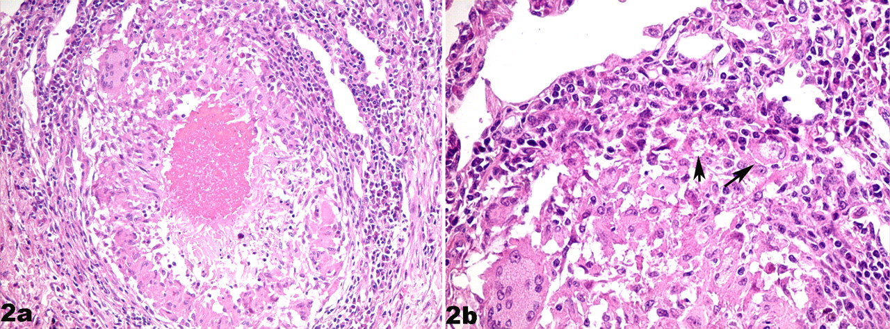
Figure 2. Lung; human.
Sakamoto K Vet Pathol 2012;49:423-439
Copyright © by American College of Veterinary Pathologists
Notes:
Lung; human. (a) The central caseum is surrounded by epithelioid macrophages, multinucleated giant cells, peripheral lymphocytes and plasma cells, and a fibrous capsule. Hematoxylin and eosin (HE). (b) This higher magnification of a portion of (a) contains foamy macrophages (arrows). HE. Courtesy of Dr. M. Kim.

