Slide 1
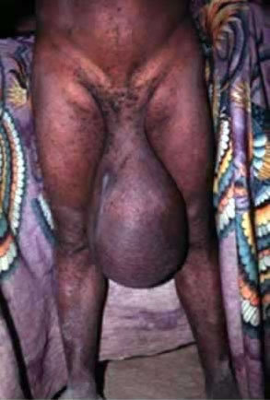
HYDROCELE

Slide 2
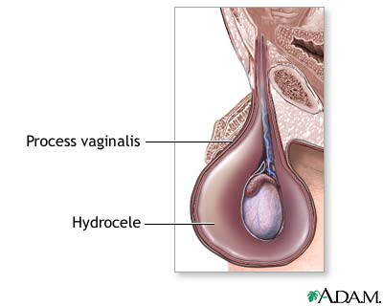
Definition
A hydrocele is an abnormal collection of serous fluid in the tunica vaginalis of testis or within some part of the processes vaginalis

Slide 3
Aetiology :
Hydrocele can be produced in four ways:-
by excessive production of fluid within the sac
eg: secondary hydrocele
by defective absorption of fluid
eg:- primary hydrocele
by interference with lymphatic drainage of scrotal wall
eg: filarial hydrocele.
by connection with peritoneal cavity
eg:- congenital Hydrocele.

Slide 4
Classification
Congenital
Acquired
Primary / Idiopathic
Secondary
Acute
Chronic

Slide 5
Primary / Idiopathic hydrocele
Five varieties
Vaginal hydrocele ( commonest )
Encysted hydrocele of the cord
Infantile hydrocele
Congenital hydrocele
Funicular hydrocele
Rare
Hydrocele of canal of NUCK
Hydrocele of the hernial sac
Hydrocele en bisac

Slide 6
Vaginal hydrocele
Commonest
Def : Abnormal accumulation of serous fluid within the tunica vaginalis
Aetiology
Defective absorption
Excessive production
Lymphatic obstruction
Rarely connection with peritoneal cavity

Slide 7
Composition
Sterile
Amber coloured
Specific gravity = 1.022 – 1.024
Water
Inorganic salts
6% of Albumin
Fibrinogen
Cholesterol crystals
Tyrosine crystals
When comes in contact with blood clots firmly

Slide 8
Clinical features
History
Age : middle age
Geographical distribution : tropical countries
Symptoms
Swelling of scrotum
Slight discomfort / pain
Local examination
Unilateral / Bilateral
Inspection
Swelling of scrotum with a notch at the middle of the swelling
Purely scrotal swelling (can get above the swelling)

Slide 9
Fluctuation test :
Positive ( usually )
Negative in large tense primary hydroceles
Transillumination test :
Brilliantly transilluminant
Not transilluminant in
Secondary hydrocele due to epididymoorchitis
Filariasis
Reducibility
Not reducible
Palpation of testis
Cannot be felt separately
In secondary hydrocele testis can be felt through the fluid

Slide 10
Transilluminant swellings
Meningocele
Ranula
Cystic hygroma
Lymph cyst
Vaginal hydrocele
Cyst of epididymis
Spermatocele
Cyst of appendage of testis
Congenital hydrocele
Congenital hernia in a child
Hydrocele of canal of NUCK

Slide 11
Scrotal swellings
Transilluminant | Non transilluminant
Vaginal hydrocele Cyst of epididymis Spermatocele Cyst of appendage of testis Congenital hydrocele Congenital hernia in a child | Tuberculous epididymoorchitis Acute epipdidymoorchitis of mumps Syphilitic orchitis Testicular tumors Old clotted hematocele varicocele

Slide 12
Primary vs secondary hydrocele
Primary hydrocele | Secondary hydrocele
Usually large Skin is normal and shiny Sac is thin Transilluminant Testis not palpated separately Idiopathic | Small Skin is thickened Sac is thick Non transilluminant Testis palpable through the swelling Secondary to Trauma Tumor Infection

Slide 13
D / D
Inguinal hernia
Hematocele
Pyocele
Chylocele
Filariasis of scrotum
Epididymal cyst
Encysted hydrocele of cord
Tumors of testis

Slide 14
Scrotal swelling
cystic
solid
Vaginal hydrocele
Epididymal cyst
Spermatocele
Chylocele
Complicated hydrocele
Tumors
Epididymoorchitis

Slide 15
Complications
Infection
Injury
Atrophy of testis
Rupture
Hematocele
Pyocele
Hernia of hydrocele sac
Calcification of sac

Slide 16
Treatment
Hydrocele
Primary
Secondary
Big
Medium
Small
Treat the cause
Orchidectomy
Tumor
Tuberculosis
Syphilis
Sub total excision of sac
Jaboulay’s eversion of sac
Lord’s plication
Sub Dartos pouch placement

Slide 17
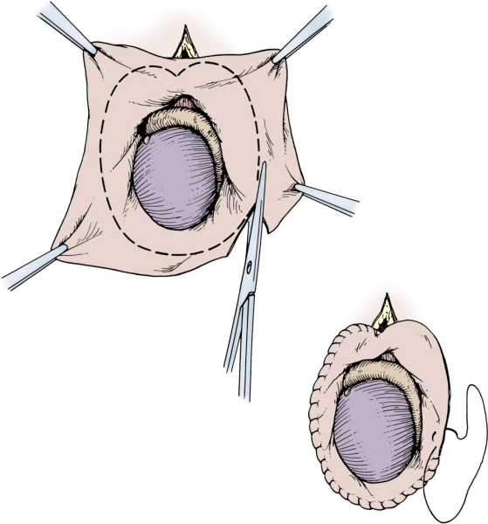
SUBTOTAL EXCISION OF SAC

Slide 18
Jaboulay's bottleneck technique for excision of thin, floppy sacs

Slide 19
LORD’S PLICATION

Slide 20
Drainage
Large hydroceles
Hematocele
Filariasis
Infected sac
Tapping
Bleeding
Injury toTestis
Infection
Recurrence
Edward Gibbon ( 1734-94 )
Sclerosant injection
Aqueous Tetracycline
Quinine HCl (4g) + Urethane (2g) + Water (30ml)
STD

Slide 21
Other varieties

Slide 22
Congenital hydrocele
Processes vaginalis remains patent
Orifice at deep ring is too small for devolopment of hernia
Diagnostic features
Present since birth
Disappears on horizontal position
Not easily reducible
Small orifice
Inverted Ink bottle effect
Associated with tuberculous peritonitis

Slide 23
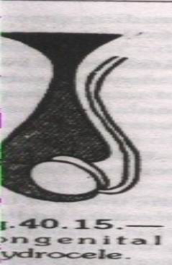
Congenital Hydrocele
The processus vaginalis remains patent.
It freely communicate with the peritoneal
cavity.
Usually communicating orifice remains
too small .
Gradually disappears ; when the patient
lies down.
It returns in the erect posture.
It may prevent emptying on digital pressure.
Bilateral cases one should exclude ascitis
from tuberculous peritonitis.

Slide 24
Infantile hydrocele
Tunica vaginalis is continous with processes vaginalis which is patent upto deep ring
Diagnostic features
Infants / adults
Inguinoscrotal swelling
Cystic
Fluctuant
Transilluminant
Doesn’t disappear on lying down

Slide 25
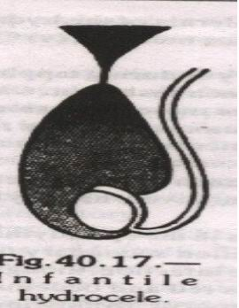
Different other types of Hydrocele
(1) Infantile Hydrocele :
Tunica & process vaginalis are
distended up to deep inguinal ring.
Do not communicate with the general
peritoneal cavity.
Does not necessarily appear in infant.

Slide 26
Funicular hydrocele
Processes vaginalis patent upto top of testis
Diagnostic features
Inguinal swelling
Testis is palpable separately

Slide 27
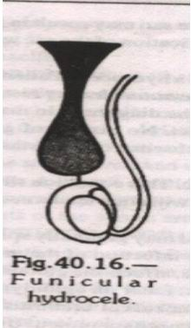
Funicular Hydrocele :
Funicular process is closed just
above the tunica vaginalis.
So it is more of a inguinal swelling.
May be confused with inguinal hernia.
Rare.

Slide 28
Encysted hydrocele of the cord
Central portion of processes vaginalis remains patent
Diagnostic features
Oval , cystic swelling in relation to cord
Inguinal / inguinoscrotal / scrotal
Fluctuant / transilluminant
Traction test

Slide 29
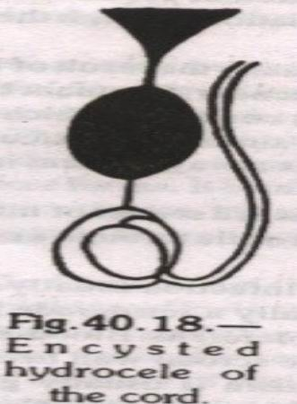
Encysted Hydrocele of the cord
A portion of funicular process remains patent
and distended with fluid.
Closed from either end
Cystic swelling
Traction test positive: On pulling the testis
the cyst also comes down.

Slide 30
Hydrocele en bisac
Bilocular hydrocele
Two intercommunicating sacs – one above & one below neck of scrotum
Upper sac has no communication with processes vaginalis & in fact it is the herniated tunica vaginalis
Cross – Fluctuation = pathognomonic

Slide 31
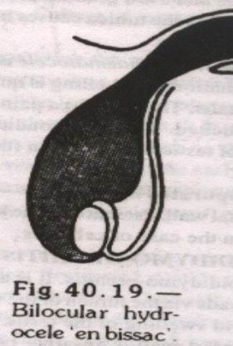
Bilocular Hydrocele en bissac
The hydrocele sac extends into the
inguinal canal up to the internal ring but
the sac is constricted in the middle,
forming two different sacs communicating
each other.

Slide 32
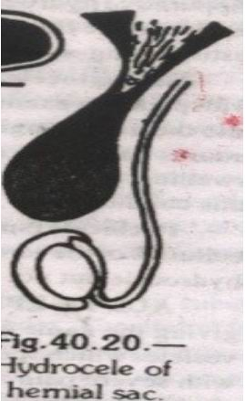
Hydrocele of hernial sac
Sometimes neck of the hernial sac gets
closed or plugged with adhesions or
omentum.
Retention of the serous fluid secreted by
peritoneum of hernial sac, result in
hydrocele.

Slide 33
Secondary hydrocele
Acute epididymoorchitis
Chronic epididymoorchitis
Syhilitic orchitis
Tumors of testis
Trauma
Lymphatic obstruction
Post herniorrhaphy hydrocele

Slide 34
Hematocele
Recent hematocele
Trauma
Tumor
Tapping
C / f
Painful
Tender
Tense
Non transilluminant
Rx
Immediate scrotal exploration
Evacuation of clots
Clean with H2O2
Loose closure with drain
Scrotal support

Slide 35
Old clotted hematocele
slow hemorrhage into tunica vaginalis
Long standing
D / D
Testicular tumor
USG
Rx
Orchidectomy

Slide 36
Secondary Hydrocele:
Secondary to:
Acute or chronic epididymo -orchitis
Syphilitic.
Malignancy
Torsion of testis.
comparatively not very big & lax.
Testis is usually palpable.

Slide 37
Lab studies:
Blood examination
ECG
CXR
Tumour markers
Urine examination

Slide 38
Imaging:
Ultrasound scan
Duplex scan

Slide 39
Hydrocele of the canal of Nuck :-
Occurs in females
Cyst lies in relation to round ligament
Always fully or partially within the inguinal canal
Postherniorrhaphy hydrocele
Relatively rare complication of inguinal hernial repair
Occurs due to interruption to the lymphatics draining of the
scrotal contents.

Slide 40
Filarial hydrocele and chylocele
Account for 80% of cases in some tropical countries; where
the parasite is endemic.
Follows repeated attacks of filarial epididymo – orchitis.
May develop slowly or very rapidly.
They vary in size
Occasionally fluids contain liquid fat which is rich in cholesterol .
This is due to rupture of lymphatic varix , with discharge of
chyle into the hydrocele.
Adult worms are sometime found in epididymis.
Long standing chylocele will have adhesions with scrotum.
Treatment –rest &aspiration.chronic cases-excision of sac

Slide 41
Surgical:
Aspiration & sclerosant injection
Open operation

Slide 42
Open Operation:
Jaboulay’s
Lord’s plication
Sharma & Jhawar’s minimal dissection
technique
Subtotal excision of sac
Marsupilisation / excision (for encysted
hydrocoele)

Slide 43
Complications:
wound infection
haematoma
injury to the vas
recurrence

Slide 44
Complication of hydrocele
(i) Rupture :
Traumatic
Spontaneous
(ii) Haematocele :
Trauma
(iii) Infection :
Suppurative hydrocele
(iv) Hernia of the Hydrocele sac.
(v) Calcification of sac wall.
(vi) Atrophy of the testes- long standing cases

Slide 45
Anaesthesia:
Local
Regional
General

Slide 46
Steps of the operation
Position
Prep
Incision
Drainage
Eversion/excision etc
Closure
Dressing

Slide 47
Indications for surgery:
Failure to resolve
Hydrocoeles with suspected pathology
eg: torsion, tumour
Symptomatic hydrocoeles
complications

Slide 48
Structures to be protected:
vas deferens
epididymis
Good haemostasis

Slide 49
Complications:
wound infection
haematoma
injury to the vas
recurrence

Slide 50
Treatment:
Medical:
conservatism
antibiotics
anti inflammatory drugs

