Slide 1
CLINICAL FEATURES,
DIAGNOSIS & MANAGEMENT OF TUBERCULOSIS
DR.P.Yugandhar
Professor Dept. of Pulmonary Medicine,ASRAM

Slide 2
CLINICAL FEATURES
SYMPTOMS:
THESE CAN BE GROUPED AS GENERALISED AND ORGAN SPECIFIC.
GENERALISED:
FEVER- USUALLY LOW GRADE,EVENING RISE.SOMETIMES MAY BE HIGH GRADE ASSO.WITH CHILLS,NIGHT SWEATS.
PUO- MAY BE THE ONLY MANIFESTATION ESP. MILIARY TB
MALAISE
LOSS OF WEIGHT
LOSS OF APPETITE.

Slide 3
ORGAN SPECIFIC:
PULMONARY:
1.COUGH- USUALLY DRY,MAY BE ASSOC. WITH MILD TO MODERATE HEMOPTYSIS, RARELY MASSIVE.PRODUCTIVE IF SEC.BACT. INFECTION..
2.CHEST PAIN- USUALLY NON SPECIFIC,UNILATERAL SHARP,STABBING IN PLEURISY/PLEURAL EFFUSION.
3.DYSPNOEA- IF COMPLICATION LIKE MODERATE TO MASSIVE PLEURAL EFFUSION OR PNEUMOTHORAX OR EXTENSIVE PARENCHYMAL INVOLVEMENT.

Slide 4
EXTRAPULMONARY:
LYMPH NODAL INVOLEMENT: MC CERVICAL LYMPH NODE
CNS - MOSTLY TB MENINGITIS
SPINAL TB – PRESENTS AS BACK PAIN, COLD ABCESS
ABDOMINAL TB – ASCITES, ILIOCEACAL TB.
CARDIAC – MC TB PERICARDITIS/PERICARDIAL EFFUSION
BONE & JOINTS- POLYARTHRITIS OR ISOLATED JOINT INVOLVMENT.
GENITO URINARY TRACT
SKIN- LUPUS VULGARIS,

Slide 5
SIGNS
PULMONARY:
THESE ARE DEPENDANT ON THE EXTENT OF DISEASE AND UNDERLYING PATHOLOGY.
IF MINIMAL DISEASE(PARENCHYMAL INVOLVEMENT) OR MILIARY TB. - NO SIGNS
IF CAVITY – CAVERNOUS BREATHING, POST TUSSIVE SUCTION.
IF FIBROSIS – BRONCHIAL BREATHING WITH MEDIUM TO COARSE CREPITATIONS.
IF PLEF OR PNEUMOTHORAX/HYDROPNEUMOTHORAX- SPEICIFIC SIGNS.

Slide 6
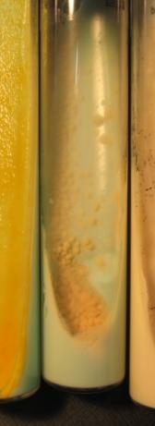


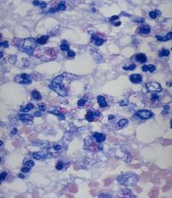
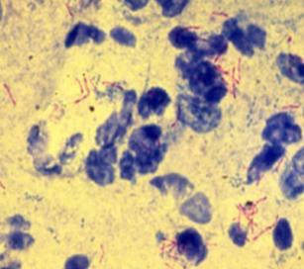
One of the main objectives for TB control
Objectives for TB control
To rapidly diagnose patients with active TB and treat them correctly.
To have rapid diagnostic methods, with high sensitivity and specificity to diagnose diseased patients at the beginning of the symptoms for an adequate treatment prescription
“Diagnosis, diagnosis & diagnosis”
William Osler
Histology
Clinical suspicion
Microbiology

Slide 7
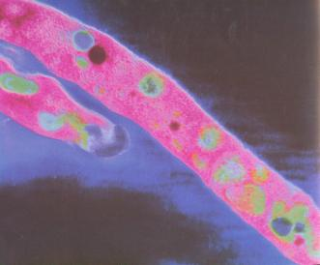
Diagnosis of tuberculosis
Latent Infection
Active tuberculosis
Smear examination
TST
Molecular
Epidemiology
Solid and liquid culture
IFN-γ techniques
Identification
RFLP
MIRU
Susceptibility testing methods
Molecular methods
Detection
Identification
Detection of resistance
Spoligotyping

Slide 8
Diagnostics Tools
GeneXpert
TrueNAT
CDST Expansion
CXR
Microscopy Centre
Notes:
Optimum use

Slide 9
Diagnostic Tools
Tools for microbiological confirmation of TB
All efforts should be undertaken for microbiologically confirming the diagnosis in presumptive TB patients. Under RNTCP, acceptable methods for microbiological diagnosis of TB are:
Drug Sensitivity Testing:
  Modified PST for MGIT 960 system (for both first and second line drugs)
  Economic variant of Proportion sensitivity testing (1%) using LJ medium (as a back up when indicated)
Notes:
Versatrek: Ability to perform additional confirmatory tests directly from the culture bottle, including smears, subcultures and direct DNA probes, user-friendly and saves time!

Slide 10
Turnaround time
  Solid LJ media- of up to 84 days,
  Liquid Culture (MGIT) up to 42 days,
  LPA up to 72 hours
  CBNAAT - 2 hours.

Slide 11
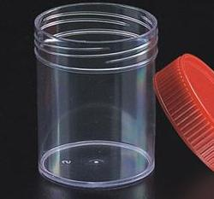
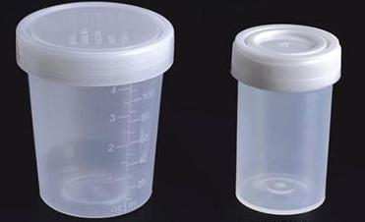

Clinical samples
Samples!! Respiratory and extra-respiratory
Quantity: high inoculums means fast growth
Quality, including sputum, high yield
Localization, biopsies when possible
Rapid shipment
Previous to starting treatment
Think of histology
The most important:
Clinical-Microbiologist-Pathologist Communication

Slide 12
Clinical samples
Samples!! Respiratory and extra-respiratory
Quantity: high inoculums means fast growth
Quality, including sputum, high yield
Localization, biopsies when possible
Rapid shipment
Previous to starting treatment
Think of histology
The most important:
Clinical-Microbiologist-Pathologist Communication

Slide 13
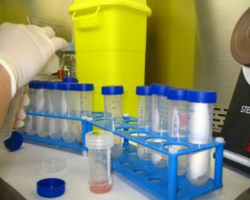
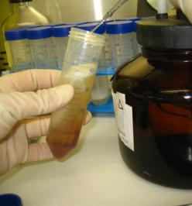
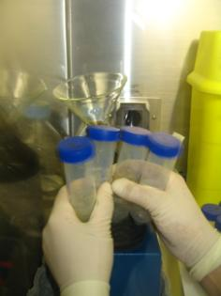
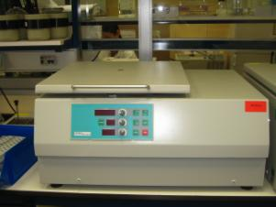
Decontamination
Eliminate normal flora from the non-sterile samples
(micobacteria is acid and alkaline resistant)
Homogenization to release the bacteria from the sample and allow access to the nutrient present in the media
i.e. Kubica
N-acetyl-cysteine: homogenization
NaOH: decontaminant
Neutralization by phosphate buffer
Homogenization
Phosphate buffer
Centrifugation
Sample mixing
Pellet

Slide 14
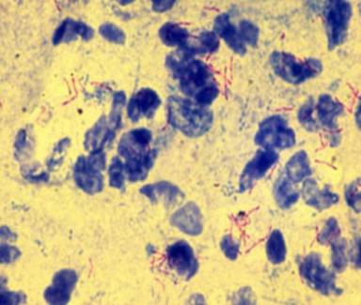
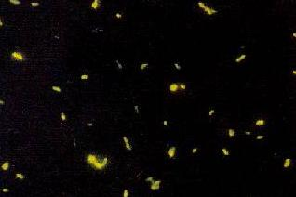
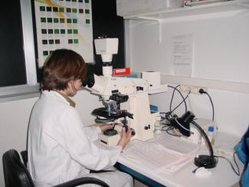
Smear microscopy
Fast; Cheap; Monitorization of treatment; Low sensitivity
Ziehl-Neelsen stain
Auramina O stain
Hospital Univ. Germans Trias i Pujol 2004 -2007
 | Pulmonary | Disseminated | Extrapulmonary*
TOTAL | 125 | 18 | 60
Positive smear | 83 (66.4%) | 11 (61.1%) | 11 (18.3%)
Negative smear | 42 (33.6%) | 7 (38.9%) | 49 (81.7%)
*Adenopathy, 4/28 (14.2%); Pleural, 1/17 (5.9%)

Slide 15
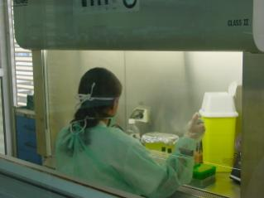
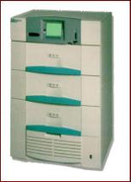

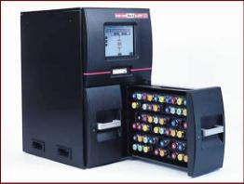
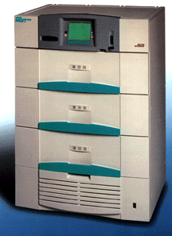
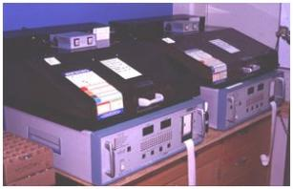
Culture in solid and liquid media
Decontamination (in non sterile samples)
Culture in the adequate media
Inoculums!!
Growth in liquid media
7-42d
Growth in solid media
Slow: 15d-2m
Division time 18h
Identification
Classical and Molecular
methods
Sometimes the only place where the mycobacteria can be isolated
Gold standard
Molecular epidemiology
Drug susceptibility testing
DST

Slide 16
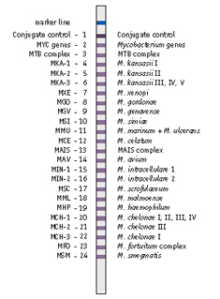
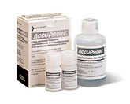
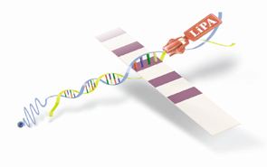
Identification molecular methods
AccuProbe
InnoLiPA Mycobacteria
GenoType Mycobacterium CM/AS, GenoType MTBC

Slide 17
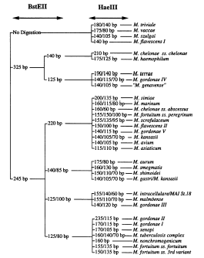
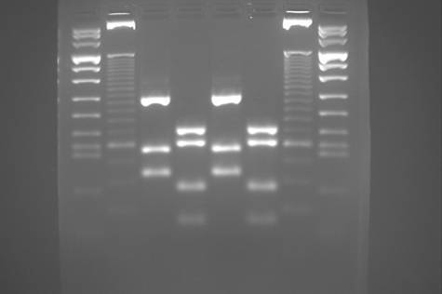
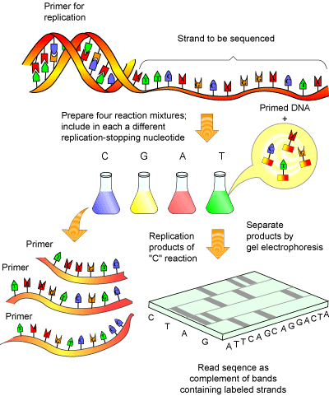
Identification molecular methods
PRA (Polymorphism Restriction Amplification)
Amplification, by PCR of a fragment of the hsp65 gen, followed by a restriction with 2 restriction enzymes (BstEII y HaeIII).
Sequencing

Slide 18
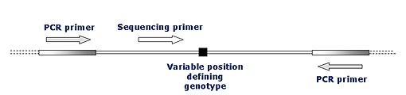
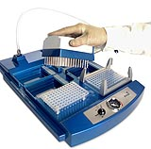
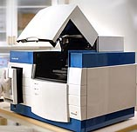
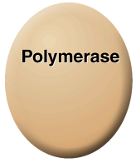
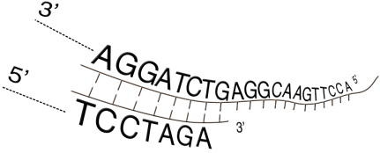





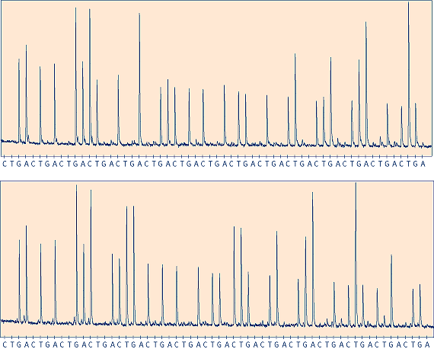






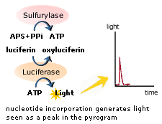
Pyrosequencing
PPi
ATP

Slide 19
M.tuberculosis detection in clinical samples by molecular methods
Method | Target | Detection method | Sensitivity in respiratory samples (%) | Sensitivity in extra respiratory samples (%) | Overall specificity (%)
AMTD2 | 16S rRNA | Chemiluminometric | 80-100 | 60-90 | 95-100
LCx | b antigenic protein | Fluorimetric | 80-90 | 65-80 | 90-100
AMPLICOR | 16S rRNA | Colorimetric | 75-100 | 45-60 | 90-100
BD ProbeTec | IS6110 and 16S rRNA | Fluorimetric | 55-100 | 30-80 | 45-100
INNO-LIPA v2 | IR16S-23S | Colorimetric | 50-95 | 60-80 | 90-100
GenoType Direct | 23S rRNA | Colorimetric | 60-95 | 60-80 | 95-100
PCR real time | 16S rRNA | Fluorimetric | 70-90 | 65-85 | 85
* In smear negative samples the sensitivity is reduced in a 50%

Slide 20


Slide 21
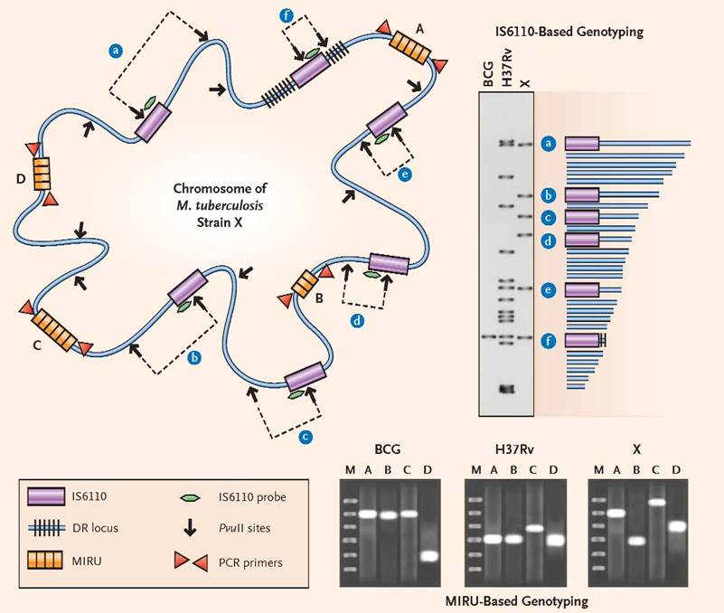
Molecular epidemiology
RFLP (IS6110)
Spoligotyping
MIRUs

Slide 22
Restriction Fragment Length Polymorphism (RFLP)
Insertion sequence present exclusively in the M.tuberculosis complex: IS6110
High polymorphism between no related strains regarding the number of copies and their localization in the chromosome.
Advantages: High discriminative power.
Disadvantages: Slow, laborious and with certain complexity.

Slide 23

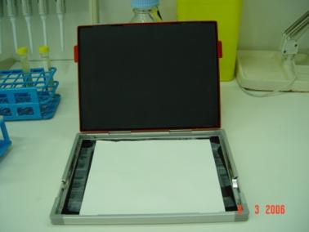
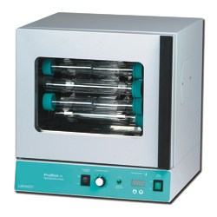
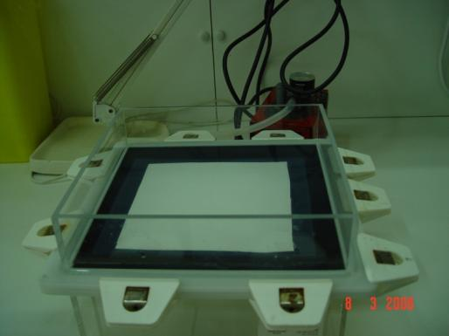
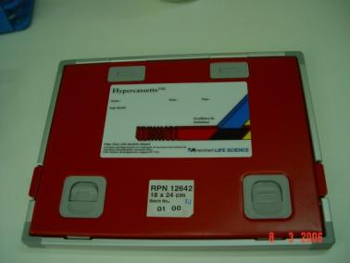
Pvu
II
Electrophoresis
Extraction and restriction
Radiographic develop
Hybridization
Transference

Slide 24
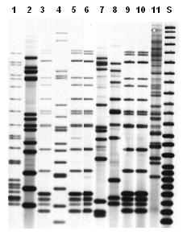

Slide 25
Conclusions
The microbiological diagnosis of TB will be rapid and accurate if adequate samples are collected and adequate inoculums are used. Don’t forget histology.
The future of TB diagnosis remains in the application of new molecular techniques but, at the moment a cautious interpretation of the results is required.
The sensitivity of the molecular tests vary, and is affected by the amount of bacteria present in the samples, and also by the clinical suspicion level. Low sensitivity is present in samples with low bacterial load, especially in extra respiratory samples.
At the moment, new molecular methods can not substitute the conventional ones. The gold-standard is the culture, and the other methods have to be considered and interpreted as complementary diagnostic methods.
Communication between clinicians and microbiologists is imperative.

Slide 26
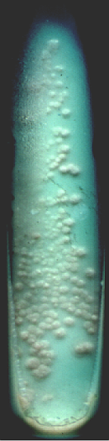
Methods for Drug Susceptibility Testing
Proportion method on
Löwenstein-Jensen medium
H, R, E, S, PTH, CM, OFL, CS, NSA (instead of P)
Results available:
4-6 weeks
No critical concentrations for new substances

Slide 27
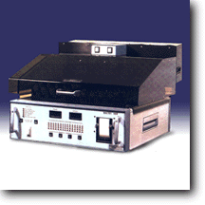
Methods for Drug Susceptibility Testing
BACTEC 460TB
All drugs except
cycloserine
Results available:
1-2 weeks
Radioactive materials, waste

Slide 28
Methods for Drug Susceptibility Testing
MGIT 960
For all drugs, except CS
Results available:
1-2 weeks

Slide 29

Liquid media compared to solid media
Advantages compared to solid media:
more rapid
high quality of media
fully automated system
testing of 1st, 2nd, and new drugs
safety: plastic tubes
Disadvantages:
expensive
higher contamination rate
dependency on a company
no DST for Cycloserine

Slide 30
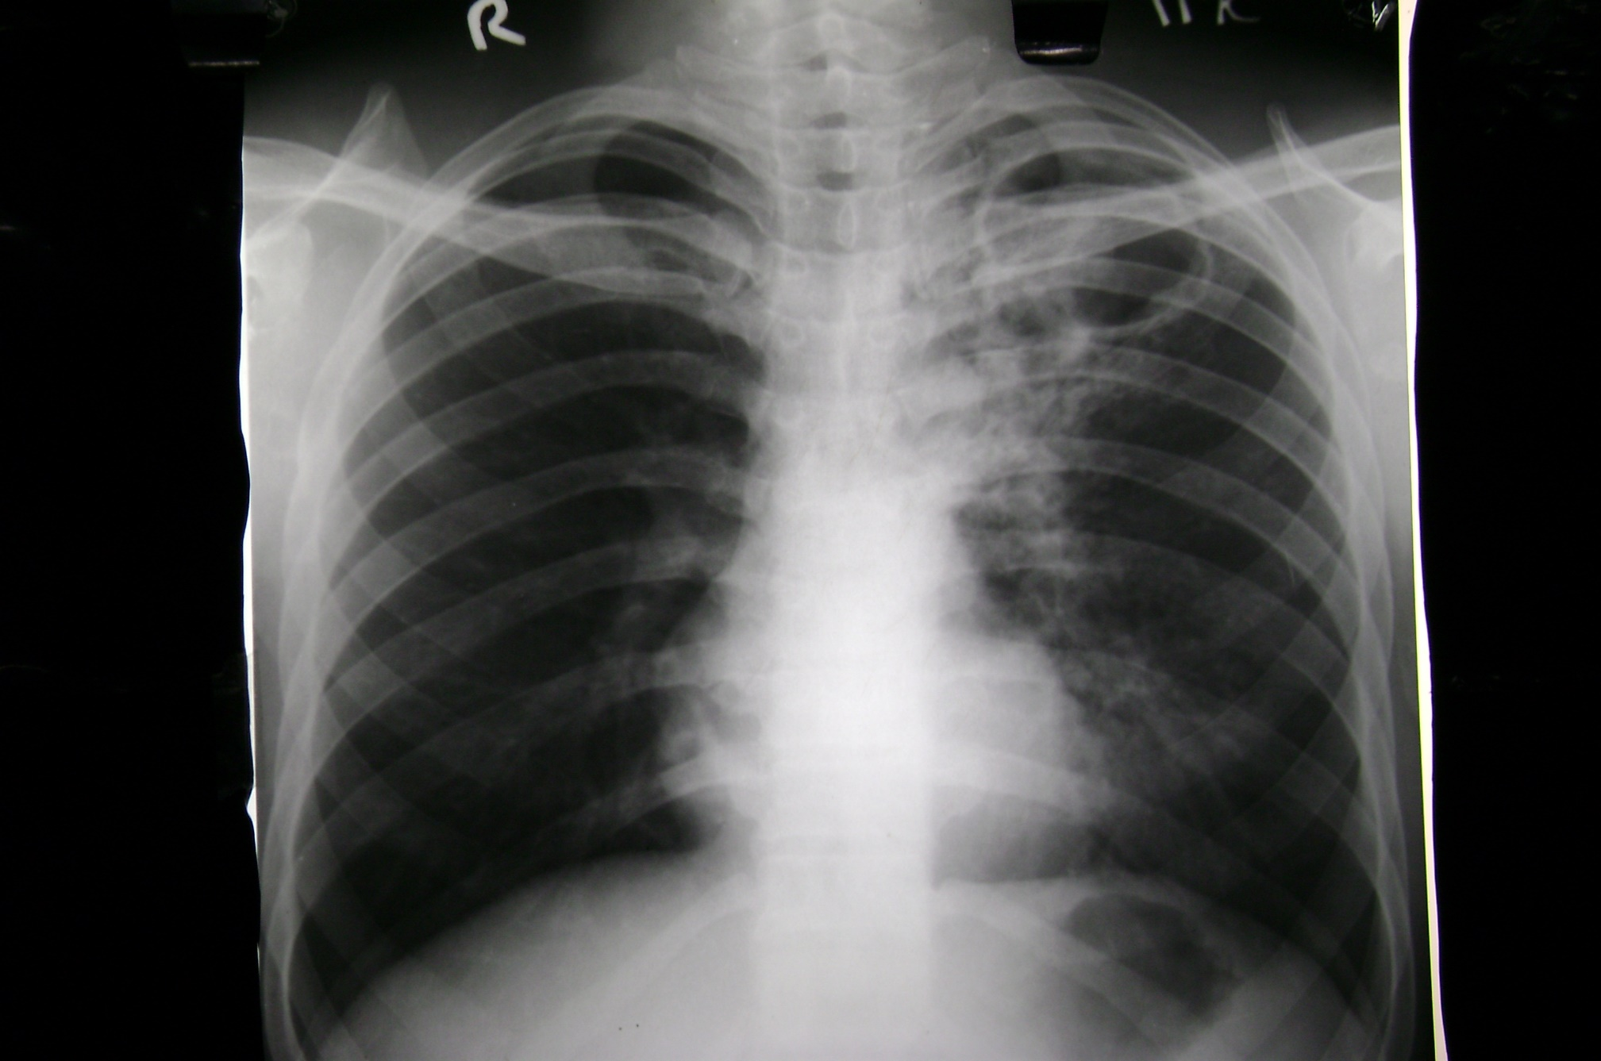
CHEST X-RAYS

Slide 31
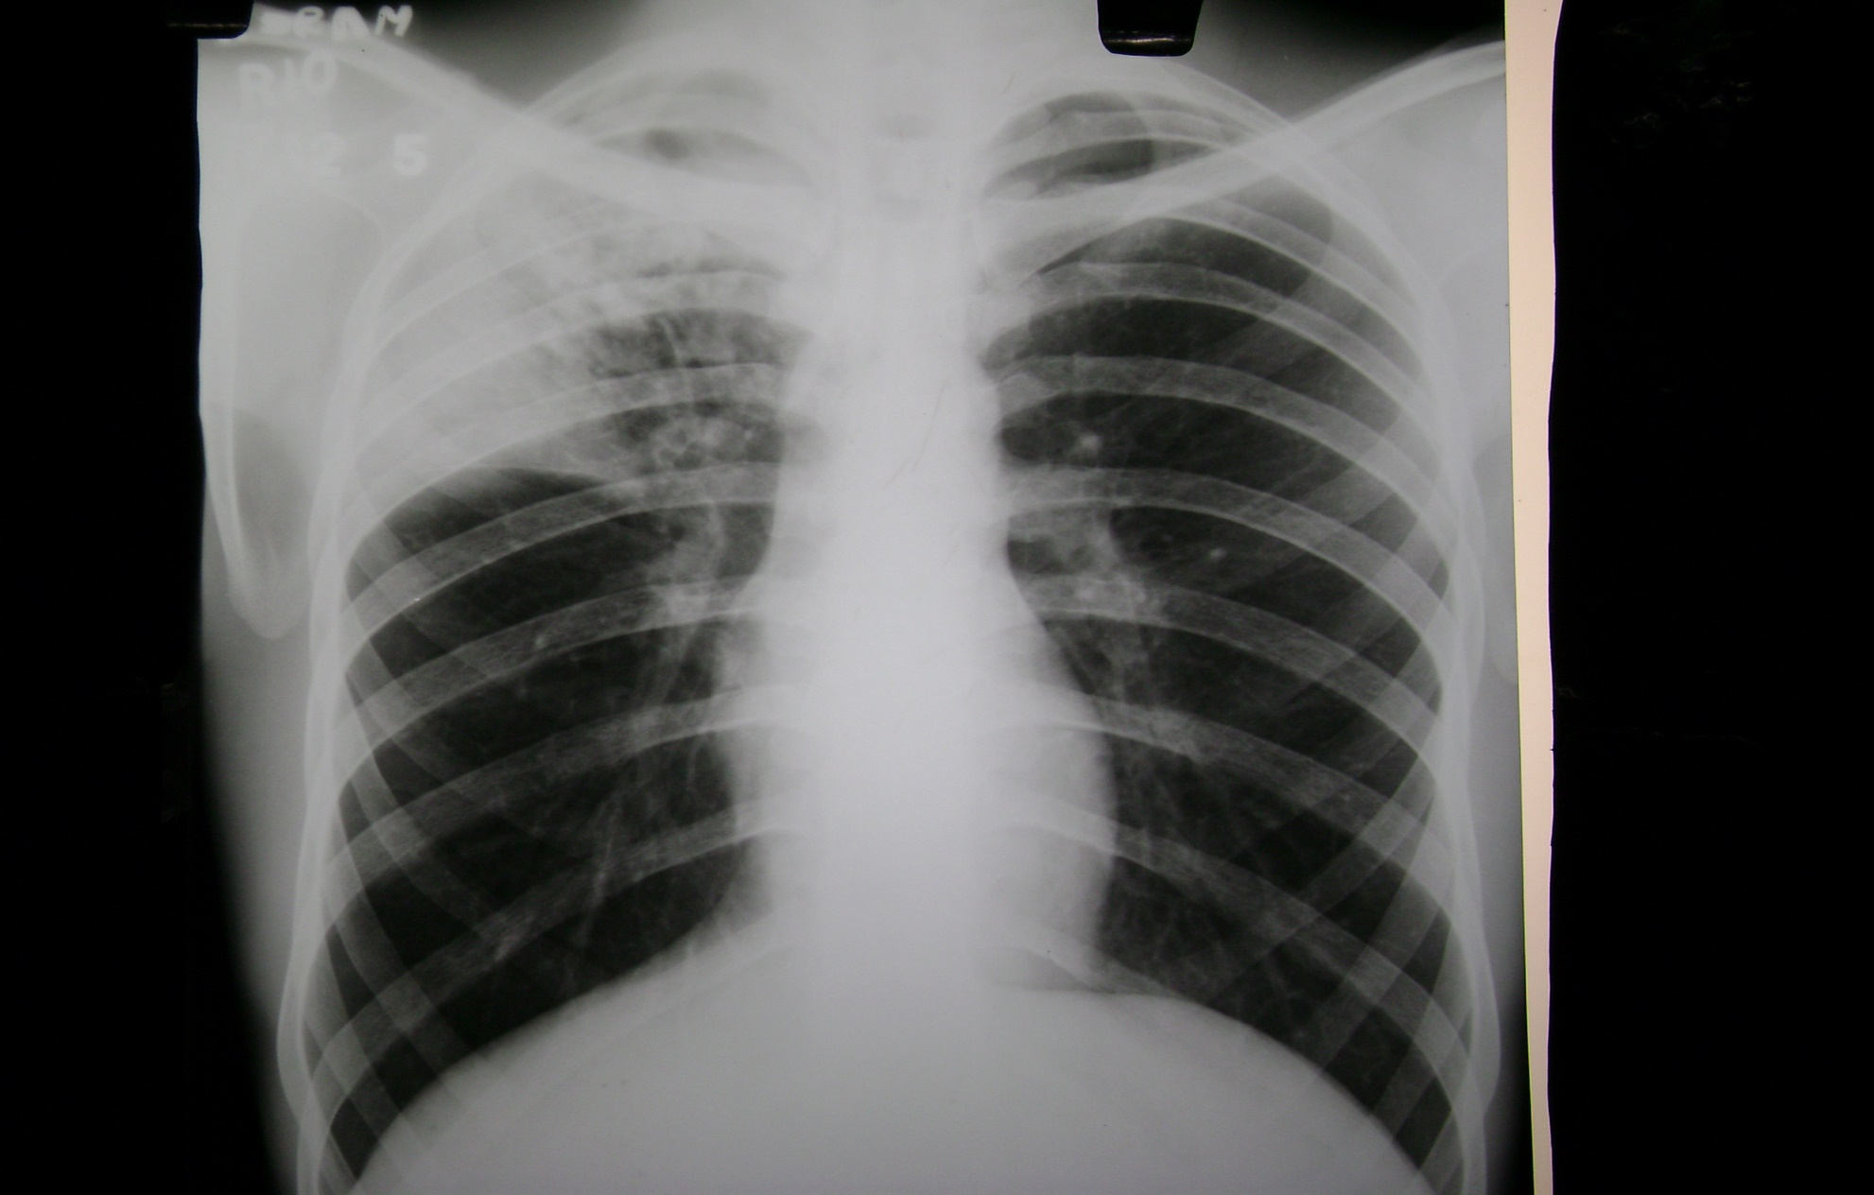

Slide 32
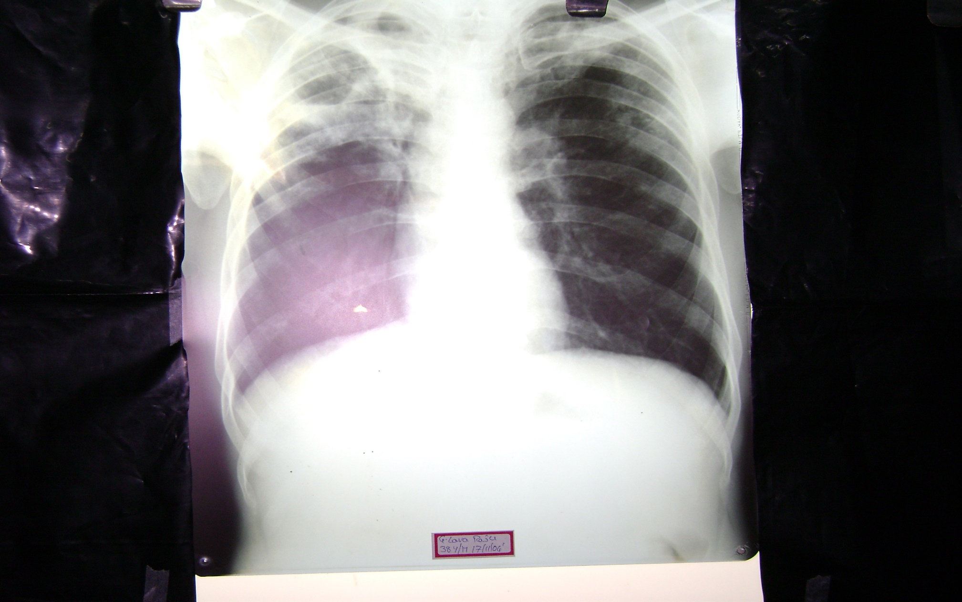

Slide 33
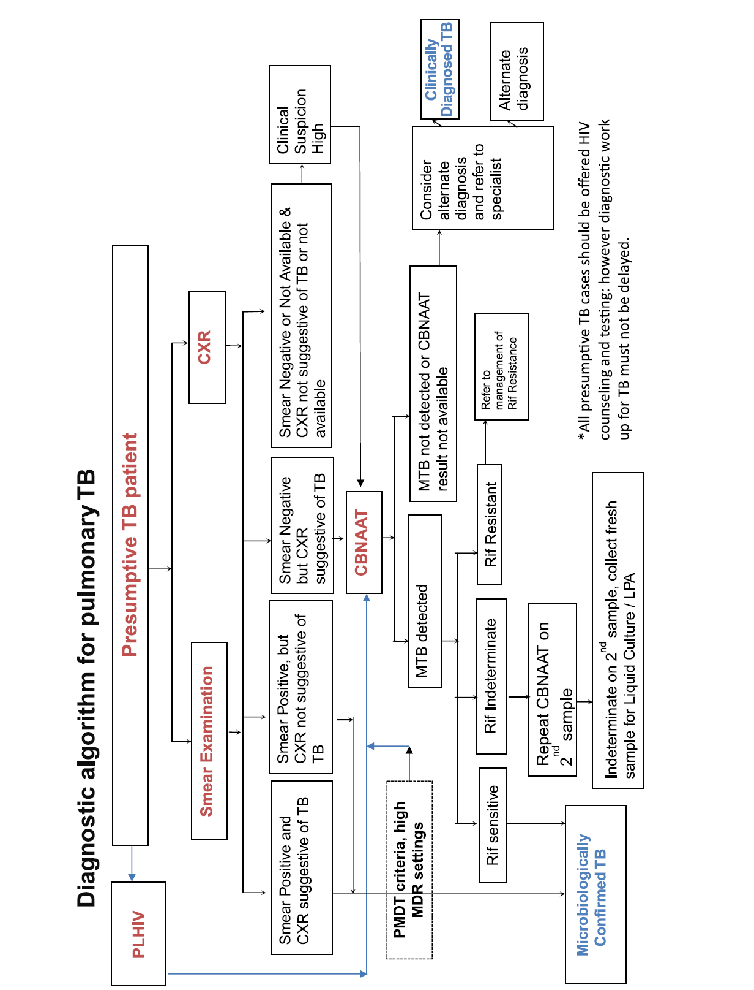
Notes:
Why direct CBNAAT in HIV: need for earlier diagnosis and TTT due to higher CFR; smear has lower sensitivity;

Slide 34
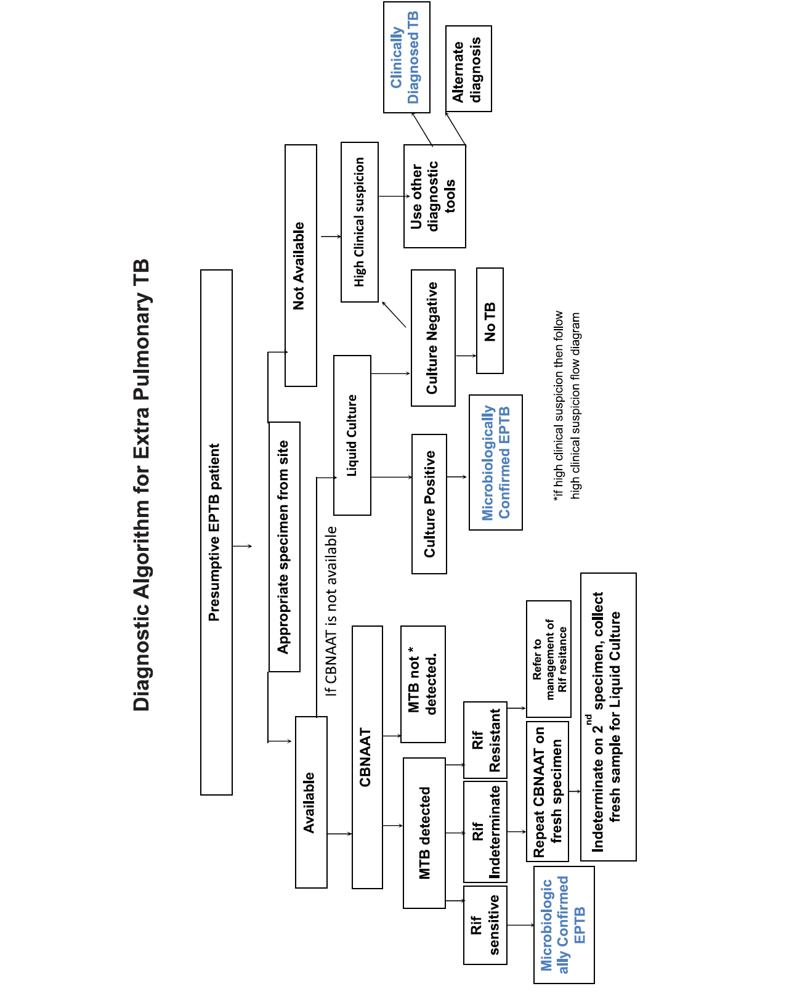
Notes:
For suspected cases of EPTB, appropriate specimen from suspected sites of involvement must be obtained for microbiological & histopathology by FNAC of LN/open or closed biopsy, though it may be difficult to obtain the specimen. In the event of Xpert negativity, culture may be advised. However, ATT can be initiated based on clinical judgement in the event of likely delay in receiving culture results. In TBM, there is need for early diagnosis, thus Xpert is preferred.

Slide 35
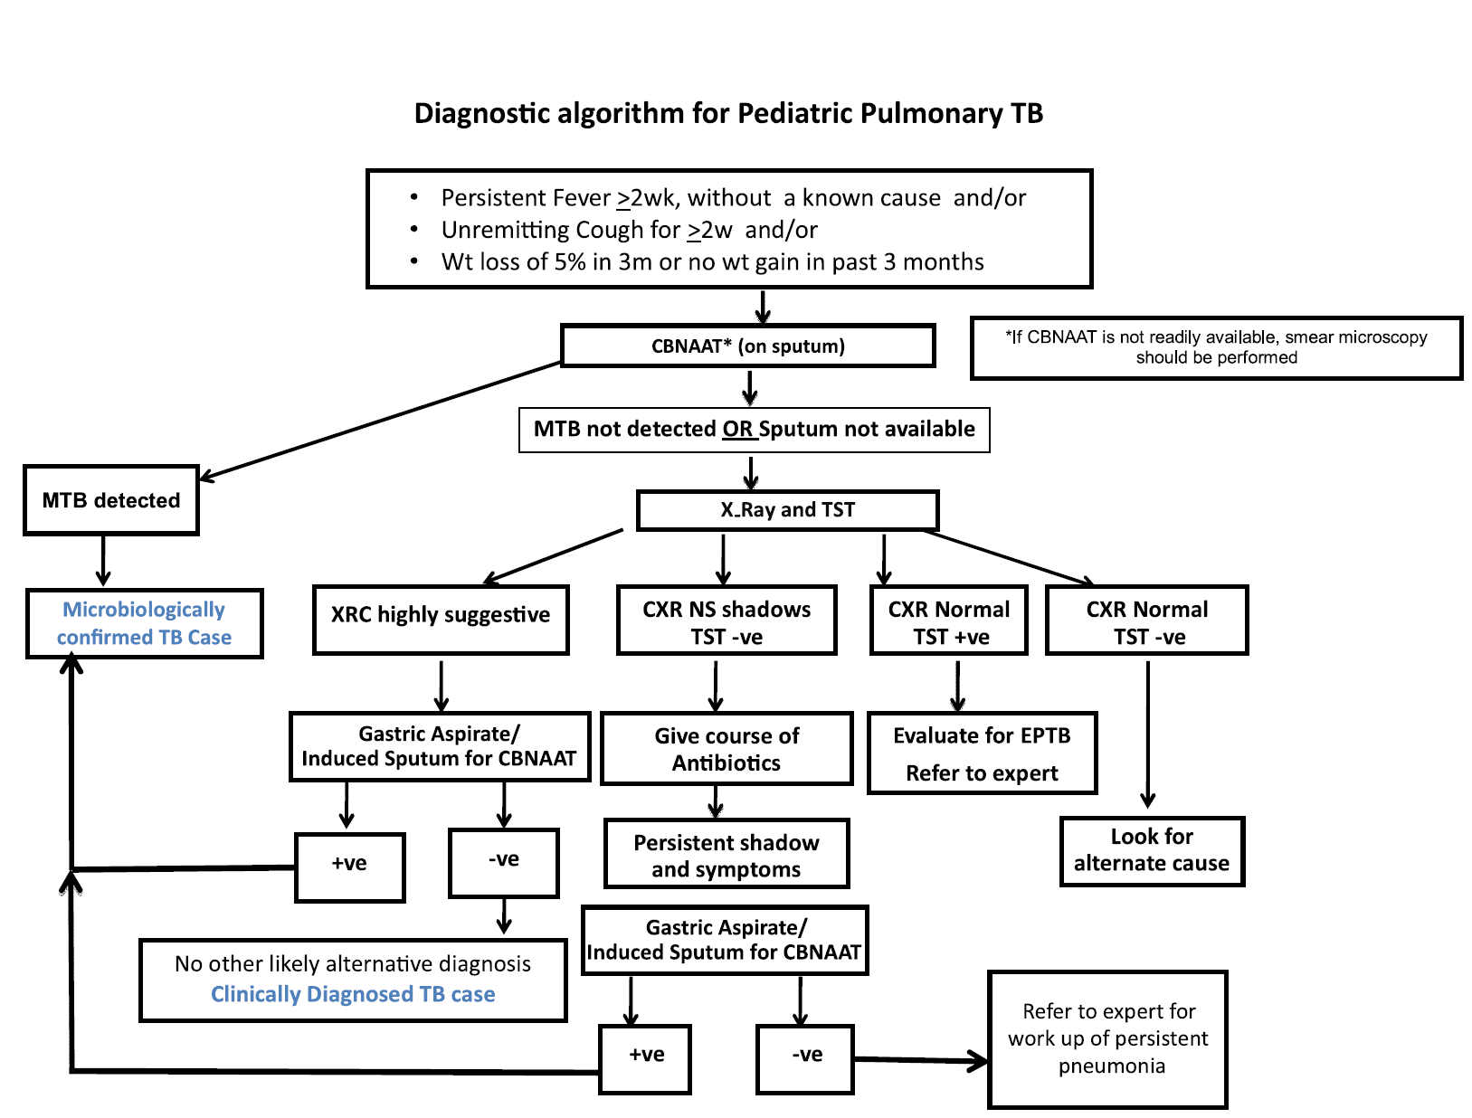
Notes:
CXR non specific shadow, TST –ve /+ve: give antibiotics

Slide 36
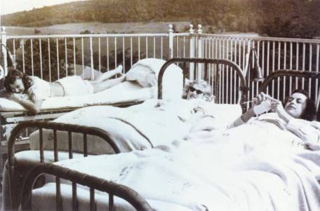
History of TB
Sanatoriums
Before TB antibiotics, many patients were sent to sanatoriums
Patients followed a regimen of bed rest, open air, and sunshine
TB patients who could not afford sanatoriums often died at home
Sanatorium patients resting outside

Slide 37
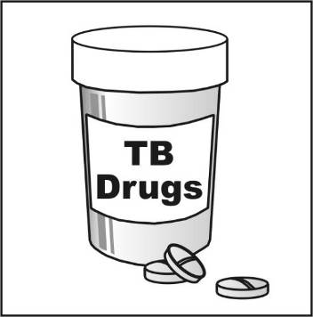
Breakthrough in the Fight Against TB
Drugs that could kill TB
bacteria were discovered
in 1940s and 1950s
Streptomycin (SM) discovered in 1943
Isoniazid (INH) and
p-aminosalicylic acid (PAS) discovered between 1943 and 1952

Slide 38
Breakthrough in the Fight Against TB (
TB death rates in U.S. began to drop dramatically
Each year, fewer people got TB
Most TB sanatoriums in U.S. had closed by mid 1970s

Slide 39

TB Resurgence
Increase in TB in mid 1980s
Contributing factors:
  Inadequate funding for TB control programs
  HIV epidemic
  Increased immigration from countries where TB is common
  Spread in homeless shelters and correctional facilities
  Increase and spread of multidrug-resistant TB
March 16, 1992 Newsweek Magazine Cover

Slide 40
TB Prevention and Control Efforts
Increased governmental funding for TB control programs beginning in 1992
Number of TB cases has steadily declined since 1993
No. of Cases
Year
Reported TB Cases, U.S., 1982-2008

Slide 41
TB History Timeline
1993: TB cases decline due to increased funding and enhanced TB control efforts
1865:
Jean-Antoine Villemin proved TB is contagious
1884:
First TB sanatorium established
in U.S.
1943: Streptomycin (SM) a drug used to treat TB is discovered
Mid-1970s: Most TB sanatoriums in U.S. closed
1840
1860
1880
1900
1920
1940
1960
1980
2000
1943-1952:
Two more drugs are discovered to treat TB: INH and PAS
1882:
Robert Koch discovers
M. tuberculosis
Mid-1980s: Unexpected rise in TB cases

Slide 42
WHAT IS DOTS?
DOTS STANDS FOR
DIRECTLY OBSREVED TREATMENT SHORTCOURSE.
IT IS IN ESSENCE THE ACT OF A RESPONSIBLE OBSERVER HOLDING THE DRUGS AND OBSERVING EACH ADMINISTRATION.
THE OBSERVER IS DEFINED AS A HEALTHCARE WORKER OR A TRAINED LAY PERSON.

Slide 43
PRINCIPLES OF DOTS STRATERGY
THERE ARE FIVE MAIN PRINCILPES OF THE WHO DOTS STRATERGY
1.POLITICAL WILL
2.CASE FINDING PRIMARILY BY MICROSCOPIC EXAMINATION OF SPUTUM OF PATIENTS PRESENTING TO TO HEALTH FACILITIES.
3.SHORT COURSE CHEMOTHERAPY GIVEN UNDER DIRECT OBSERVATION.
ADEQUATE SUPPLY OF DRUGS
5.SYSTEMATIC MONITORING AND ACCOUNTABILITY FOR EVERY PATIENT DIAGNOSED.

Slide 44
SCIENTIFIC BASIS OF DOTS
THE EFFICACY OF SHORT COURSE INTERMITTENT CHEMOTHERAPY HAS BEEN CONCLUSIVELY DEMONSTRATED IN CONTROLLED CLINICAL TRIALS IN INDIA AND ELSEWHERE FOR BOTH PULMONARY AND EXTRAPULMONARY TB.
INITIALLY INH AND RIFAMPICIN WITH OR WITHOUT OTHER DRUGS WERE TO BE GIVEN FOR 9 MONTHS,BUT LATER THE ADDITION OF PYRAZINAMIDE FOR THE FIRST 2 MONTHS REDUCED THE TOTAL DURATION OF TREATMENT TO 6 MONTHS.
INTERMITTENT REGIMEN WAS WELL TOLERATED IN THE TRIALS,HOWEVER INTERMITTENT TREATMENT SHOULD BE GIVEN IN A PROGRAMME OF DIRECT OBSERVATION .

Slide 45
BIOLOGICAL MECHANISM OF
INTERMMITENT CHEMOTHERAPY
WHAT IS LAG PERIOD?
IN VITRO EXPERIMENTS DEMONSTRATED THAT AFTER A CULTURE OF M.TUBERCULOSIS HAS BEN EXPOSED CERTAIN DRUGS FOR SOME TIME IT TOOK SEVERAL DAYS BEFORE GROWTH OCCURRED.THIS GAP WHICH VARIES FOR EACH DRUG IS KNOWN AS LAG PERIOD.ONLY THIACETAZONE DOES NOT PRODUCE LAG PERIOD.

Slide 46
WHAT IS RNTCP?
RNTCP IS AN APPLICATION TO INDIA OF THE W.H.O. RESOMMENDED DOT STRATEGY.IN ORDER TO IMPLEMENT THE PROGRAMME, WHICH WAS LAUNCHED IN 1997 TO START WITH BUT NOW COVERING THE ENTIRE NATION. IT’S AN ORGANISATIONAL SRTUCTURE COMPRISING:
CENTRAL TB DIVISION,UNDER DGHS N.DELHI
STATE TB HEAD QUARTERS AND STATE TB TRAINING AND DEMONSTRATION CENTRES(STDC’S).
DISTRICT TB CENTRE(DTC’S).

Slide 47
TUBERCULOSIS UNITS(TUs) at SUBDISTRICT LEVEL COVERING aprox. 5 lakh POPULATION AND INCLUDES ONE SENOIR TREATMENT SUPERVISOR (STS) & SENOIR TUBERCULOSIS LAB SUPERVISOR(STLS) AND MEDICAL OFFICER TUBERCULOSIS CONTROL(MOTC) WHO IS RESPONSIBLE FOR THE PROGRAMME IMPLEMENTATION AT TU LEVEL.
MICROSCOPY CENTRE FOR EVERY ONE LAKH POPULATION WITH TRAINED LAB TECHNICIAN TO PROVIDE FOR DIAGNOSTIC SERVICE AT THE NEAREST POSSIBLE PLACE.

Slide 48
STOP TB STRATEGY
In 2006, the new stop TB strategy was recommended internationally by WHO. The components of the new stop TB strategy are the following:
  1.Pursue High quality DOTS expansion and enhancement
  2.Address TB/HIV, MDR-TB and other challenges
  3.Contribute to health system strengthening
  4.Engage all health care providers
  5.Empower people with TB, and communities
  6.Enable and promote research .

Slide 49
GOAL OF RNTCP
THE GOAL OF RNTCP IS ENSURE THAT AT LEAST 85% OF ALL SPUTUM POSITIVE CASES ARE CURED AND THUS THE TRANSMISSION OF TUBERCULOSIS IS INTERRUPTRED.AS EFFECTIVE TREATMENT OF SMEAR POSITIVE PATIENTS STOPS TB AT THE SOURCE AND IS THE TOP PRIORITY FOR THE CONTROL OF THE DISEASE.

Slide 50
TRAEATMENT GUIDELINES
DRUGS AVAILABLE CURRENTLY:
Ist LINE DRUGS:
1.ISONIAZID(INH):MOST WIDELY USED DRUG, BACTERICIDAL, NON-TOXIC EASILY ADMINISTERED AND CHEAP.IT IS COMPLETELY ABSORBED FROM THE GIT AND PENETRATES INTO ALL BODY FLUIDS AND CAVITIES PRODUCING CONCEBTRATION SIMILAR TO THE SERUM.
DOSE:3 to 5 mg/kg Max OF 300mg/day OR 10mg/kg IN ALT.DAY.
SIDE EFFECTS:HEPATITIS IS THE MAJOR SIDE EFFECTS,PERIPHERAL NEUROPATHY,MILD GASTRITIS AND RASH.

Slide 51
2.Rifampicin:IS THE MOST EFFECTIVE DRUG TILLDATE,BACTERICIDAL AND WELL ABSORBED AFTER ORAL ADMINISTRATION(empty stomach).THOUGH 75% IS PROTEIN BOUND IT EASILY PENETRATES ALL TISSUES.THRERAPUETIC CONCENTRATIONS ARE ACHIEVED IN INFLAMMED MENINGES.CAUSES ORANGE/REDDISH DISCOLORATION OF BODY FLUIDS.
DOSE:10mg/kg IN ANY REGIMEN UPTO MAX.OF 600mg/Day.
SIDE EFFECTS:M.C IS GI UPSET,OTHERS LIKE HEPATITIS,RASH, THROMBOCYTOPENIA ARE NOT COMMON.RIFAMPICIN IS HEPATIC MICROSOMAL INDUCER AND HENCE MAY ACCELERATE METABOLISM OF DRUGS LIKE GLUCOCORTICOIDS,ESTROGENS,OHA’S DIGITOXIN,ANTI CONVULSANTS KETOCONAZOLE ANTI ARRHYTHMIC AGENTS,THE DOSES OF WHICH HAVE TO INCREASED AS PER RECOMMENDATION.

Slide 52
3.PYRAZINAMIDE:I S BACTERICIDAL IN ACIDIC ENVIRONMENT ESPECIALLY WITHIN THE MACRIPHAGES.PENETRATES INTO ALL TISSUES INCL. C.S.F.
DOSAGE:25mg/kg DAILY REGIMEN,35-40mg/kg INT.REGIMEN.
SIDE EFFECTS:M.C. IS HEPATOTOXICITY,ARTHRALGIA DUE HYPERURICEMIA,SKIN RASH AND GI INTOLERANCE ARE ALSO SEEN.
4.ETHAMBUTOL:IS BACTERIOSTATIC,IS WELL ABSORBED AND WELL TOLERATED.HOWEVER ITS HALF IS PROLONGED IN PATIENTS WITH RENAL IMPAIRMENT IN WHOM DOSES HAVE TO ADJUSTED.C.S.F. CONC. ARE LOW.
DOSAGE:15mg/kg daily regimen,30-40mg/kg INT.REGIMEN.
SIDE EFFECTS: M.C. IS RED-GREEN BLINDNESS AND CENTRAL SCOTOMA DUE TO RETRO BULBAR NEURITIS.

Slide 53
5.STREPTOMYCIN:IS BACTERICIDAL IN ALKALINE ENVIRONMENT.PENETRATES INTO ALL TISSUES AND C.S.F. ALSO WHEN INFLAMMED.EXCRETION IS ENTIRELY RENAL AND CAUTION IS NEEDED IN RENAL FAILURE.
DOSAGE:15mg/kg IN ANY REGIMEN ,MAX. OF 1GM/DAY.
SIDE EFFECTS: M.C. IS OTOTOXICITY.THIS RESULTS IN VERTIGO(VESTIBULOTOXIC) AND HEARING LOSS ALSO.BOTH OTOTOXICITY AND NEPHROTOXICITY ARE MORE IN PRESENCE OF PRE-EXISTING DISEASE.

Slide 54
2nd LINE DRUGS
1.P.A.S(PARA AMINO SALICYLIC ACID)
2.ETHIONAMIDE&PROTHIONAMIDE
3.CYCLOSERINE
4.CAPREOMYCIN
5.KANAMYCIN
6.THIACETAZONE.
7.FLUOROQUINOLONES-CIPRO,LEVO,MOXI,GEMIFLOXACIN etc.
8.RIFABUTIN
9.CLOFAZIMINE
10.NEWER MACROLIDES-AZITHRO & CLARITHROMYCIN.

Slide 55
Classes of Anti TB Drugs recommended for treatment of DR-TB
New Grouping of Drugs
A. Fluoroquinolones | Levofloxacin Moxifloxacin Gatifloxacin |  | Lfx Mfx Gfx
B. Second-line injectable agents | Amikacin Capreomycin Kanamycin (Streptomycin) |  | Am Cm Km (S)
C. Other second-line agents | Ethionamide / Prothionamide Cycloserine / Terizidone Linezolid Clofazimine |  | Eto/Pto Cs/Trd Lzd Cfz
D. Add-on agents (not part of the core MDR-TB regimen) | D1 | Pyrazinamide Ethambutol High-dose isoniazid | Z E H^{h}
 | D2 | Bedaquiline Delamanid | Bdq Dlm
 | D3 | p-aminosalicylic acid Imipenem-cilastatin Meropenem Amoxicillin-clavulanate (Thioacetazone) | PAS Ipm/Cls Mpm Amx-Clv (T)

Slide 56
REGIMENS
TREATMENT CAT | PATIENTS TYPE | INITIAL- PHASE 3 TIMES/WK | CONTINUATION- PHASE
I | NEW SMEAR POSITIVE PTB,NEW SMEAR NEGATIVE PTB WITH EXT. PARENCHYMAL INVOLVEMENT, NEW SEVERE FORMS OF EXTRA PULM.TB | 2 (EHRZ)3 OR 2 (EHRZ)3 | 6(HE)3- 4 (HR)3
II | SPUTUM SMEAR POSITIVE: RELAPSE,TREATMENT FAILURE,AFTER DEFAULT | 2 SHRZE/1HRZE)3 | 5 (HRE)3
III | NEW SMEAR NEGATIVE PTB(MILD CASES),LESS SEVERE FORMS OF EXT.PULM TB | 2 (HRZ)3 OR 2 (HRZ)3 | 6 HE OR 4(HR)3

Slide 57
TREATMENT REGIMENS IN SPECIAL SITUATIONS
PREGNANT&LACTATING WOMEN:
MOST OF THE ANTI TB DRUGS EXCEPT STREPTOMYCIN ARE SAFE IN PREGANANCY,WHICH IS OTOTOXIC TO THE FETUS.
SUCCESFULLTREATMENT WITH STANDARD REGIMENS IS IMPORTANT FOR SUCESSFULL OUTCOME OF PREGNANCY .
ALL ANTI TB DRUGS ARE SAFE AND COMPATIBLE WITH BREAST FEEDING.
THE MOTHER AND BABY SHOULD STAY TOGETHER AND BABY SHOULD CONTINUE TO BREASTFEED IN THE NORMAL WAY BECAUSE TIMELY CHEMOTHERAPY IS THE BEST WAY TO PREVENT TRANSMISSION OF TB BACILLI TO HER BABY.
HOWEVER THE BABY SHOULD RECEIVE I.N.H. PROPHYLAXIS AND BCG IMMUNISATION.

Slide 58
TREATMENT IN LIVER DISORDER:
PATIENTS CAN RECEIVE USUAL REGIMENS PROVIDED THERE IS NO EVIDENCE OF CHRONIC LIVER DISEASE ,HEPATITIS VIRUS CARRIAGE,EXCESSIVE ALCOHOL CONSUMPTION OR A PAST H/O OF ACUTE HEPATIS.
ESTABLISHED CHRONIC LIVER DISEASE:PYRAZINAMIDE IS CONTRAINDICATED.RECOMMENDED REGIMENS:
2SHRE/6HR-TOTAL 8 MONTHS OR 2SHE /1O HE(12MONTHS)
ACUTE HEPATITIS:IN CASE BOTHE ACUTE HEPATITIS AND TB OCCUR AT THE SAME TIME THEN CLINICAL JUDGEMENT SHOULD BE USED.IF POSSIBLE DEFER TB TREATMENT TILL HEPATITIS IS RESOLVED.HOWEVER IF NECESSARY TO TREAT TB THEN
3 MONTHS S E (TILL HEPATITIS IS RESOLVED)+ 6HR (C.P.) IS THE SAFEST OPTION.

Slide 59
RENAL FAILURE:
I.N.H. ,RIF &PYRAZINAMIDE ARE RELATIVE SAFE AS THEY ARE EXCRETED IN BILE.
STREPTOMYCIN &ETHAMBUTOL ARE EXCRETION BY THE KIDNEY HENCE THEY ARE RELATIVELY CONTRAINDICATED, CAN BE GIVEN IN REDUCED DOSES, WHEREVER RENAL FUNCTION CAN BE CLOSELY MONITORED.
2 HRZ+/6HR IS THE SAFEST REGIMEN

Slide 60
Extra-pulmonary TB
Refers to any microbiologically confirmed or clinically diagnosed case of TB involving organs other than the lungs such as Lymph nodes, pleura, bones and joints, meninges of the brain, intestine, genito-urinary tract, etc
A high level of suspicion is important in patients with suggestive symptoms and signs

Slide 61
Daily Dose Schedule for Adults
(as per weight bands)
Weight band | Number of tablets |  | Inj. Streptomycin
 | Intensive phase | Continuation phase
 | HRZE | HRE
 | 75/150/400/275 mg | 75/150/275 mg | gm
25-39 kg | 2 | 2 | 0.5 gm
40-54 kg | 3 | 3 | 0.75 gm
55-69 kg | 4 | 4 | 1 gm
≥70 | 5 | 5 | 1 gm

Slide 62
Drug dosages for anti-TB drugs
Drugs | Adult | Children
Isoniazid | 5 mg/kg (4 to 6 mg/kg) daily | 10 mg/kg (7-15 mg/kg) daily
Rifampicin | 10 mg/kg (8-12 mg/kg) daily | 15 mg/kg (10-20 mg/kg) daily
Pyrazinamide | 25 mg/kg (20-30 mg/kg) daily | 35 mg/kg (30-40 mg/kg) daily
Ethambutol | 15mg/kg (12-18 mg/kg) daily | 20 mg/kg (15-25 mg/kg) daily
Streptomycin | 15 mg/kg (15-20 mg/kg) daily | 15 mg/kg (12-18 mg/kg) daily

Slide 63
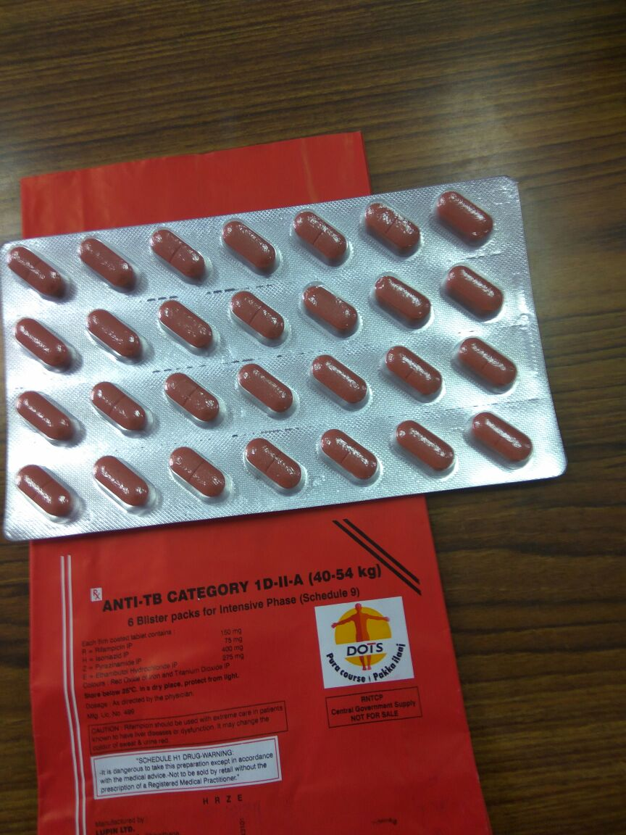
4FDC

Slide 64
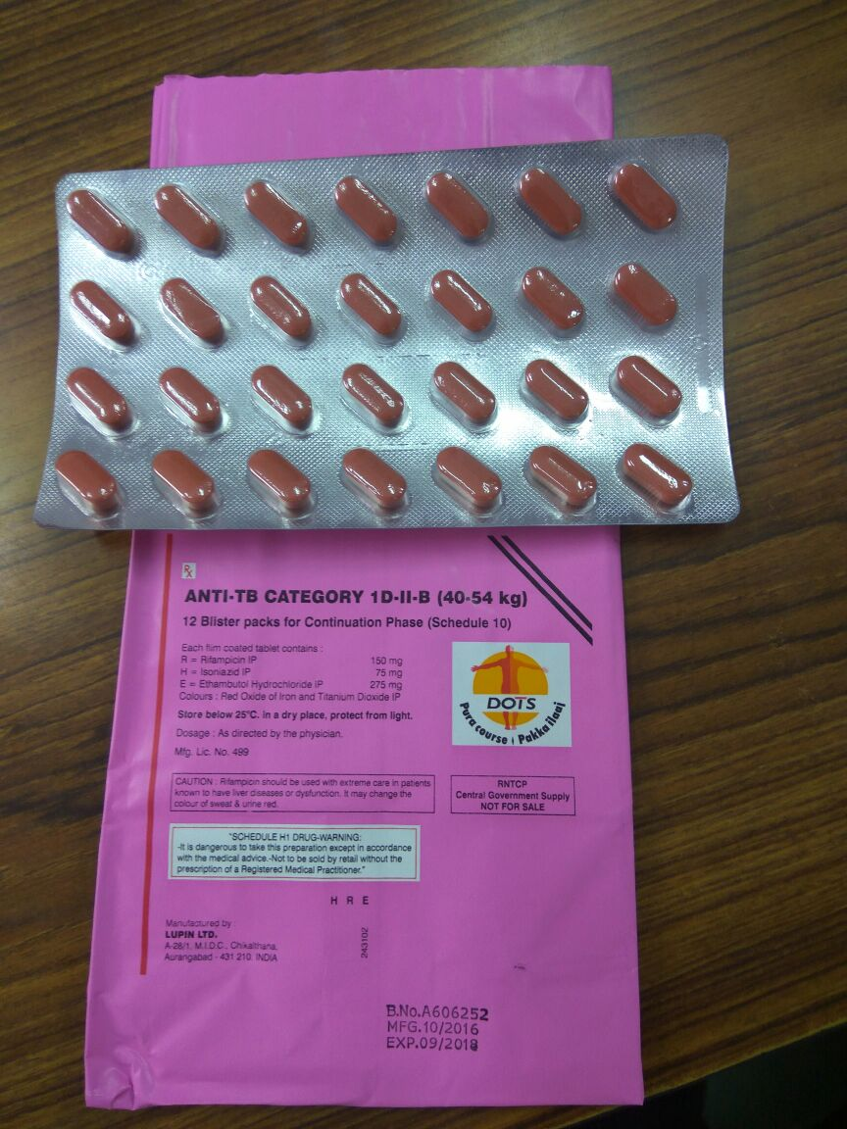
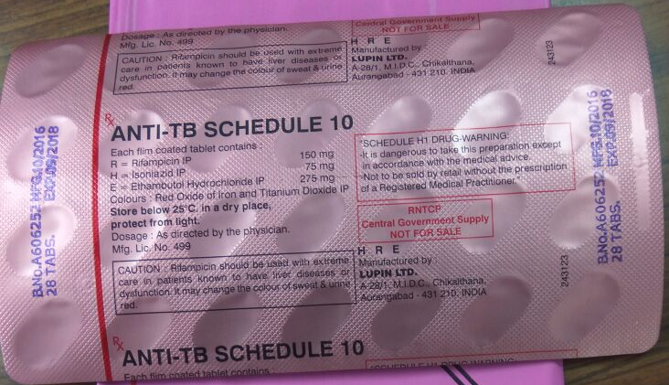
3FDC

Slide 65
Drug Dosage for Paediatric TB
Weight category | Number of tablets (dispersible FDCs) |  |  |  | Inj. Streptomycin
 | Intensive phase |  | Continuation phase
 | HRZ | E | HR | E
 | 50/75/150 | 100 | 50/75 | 100 | mg
4-7 kg | 1 | 1 | 1 | 1 | 100
8-11 kg | 2 | 2 | 2 | 2 | 150
12-15 kg | 3 | 3 | 3 | 3 | 200
16-24 kg | 4 | 4 | 4 | 4 | 300
25-29 kg | 3 + 1A* | 3 | 3 + 1A* | 3 | 400
30-39 kg | 2 + 2A* | 2 | 2 + 2A* | 2 | 500
*A=Adult FDC (HRZE = 75/150/400/275; HRE = 75/150/275)

