Slide 1
Dysphagia
Dr S Jaya Sandeep

Slide 2
Introduction
Dysphagia refers to difficulty in swallowing which results from interference or obstruction to the food passage.
It can be divided into two types:
Oropharyngeal (difficulty in transferring food bolus from oropharynx to upper esophagus)
Esophageal (difficulty in transporting bolus through the body of
esophagus).

Slide 3
ODYNOPHAGIA : painful swallow. is more marked in ulcerative and inflammatory lesions of food passages-oral cavity, oropharynx and oesophagus.
Patient with dysphagia may complaint of :
Foreign body sensation
Throat discomfort
Feel of hold up
Absolute difficulty in swallowing

Slide 4
Stages of deglutition
Oral phase
Mastication
Salivation
Movement of tongue, soft palate
Pharyngeal phase
Closure of oral, nasopharyngeal isthmus and larynx.
Opening of cricopharynx
Esophageal phase
Involuntary propulsion of bolus

Slide 5
Causes

Slide 7
Evaluation
History
Sudden onset: Foreign body or impaction of food on a stricture or malignancy, and neurological lesions.
Gradually progressive: Malignancy (short history with weight loss) and peptic strictures (long history with heartburn).
Chronic, continuous and not progressive: Stricture.
Intermittent: Spasms or spasmodic episodes over an organic lesion.
Liquids/solids: More with liquids (paralytic lesions), more with solids, and progressing to liquids (malignancy).

.

Slide 8
Intolerance to acid food and fruit juices: Ulcerative lesions.
Associated complaints:
Regurgitation and heartburn: Hiatus hernia.
Regurgitation of undigested food in lying down and
coughing in night: Hypopharyngeal diverticulum.
Nasal regurgitation: Palatal paralysis.
Aspiration into lungs: Laryngeal paralysis.

Slide 9
Physical Examination
The physical examination should include oral cavity, oropharynx, hypopharynx, larynx, neck, chest and nervous system including cranial nerves.
The lesions of oral cavity and pharynx can be seen during physical examination whereas esophageal causes require investigations such as barium swallow and esophagoscopy.

Slide 10
Investigations
Upper endoscopy, barium swallow, manometry and pH
recording are the mainstay of dysphagia evaluation.

Hemogram: Iron deficiency anemia in Plummer-Vinson
syndrome.

X-ray chest: For advanced esophageal lesions, cardiovascular,
pulmonary and mediastinal diseases or pneumomediastinum

Slide 11
X-ray neck lateral and frontal projections: For cervical osteophytes, lesions of post-cricoid or retropharyngeal region.
a. Useful in children.
b. Shows radiopaque foreign bodies.
c. Saying “e” during exposure brings the tongue anterior,
and shows oropharynx better.
d. Blowing through closed mouth distends hypopharynx.

Slide 12
Computed radiography and digital radiography: In this filmless technique, image is captured on an array of digital elements, and is read directly into a computer.
Advantages:
Soft tissue differences: It can emphasize subtle soft tissue differences even if the image is suboptimally exposed.
Invert image: Radiodense elements appear whiter than radiolucent elements on traditional films but computer technology can invert the image and some aspects of anatomy, and pathology can be visualized better.

Slide 13
Barium swallow: For malignancy, cardiac achalasia, strictures,
diverticulum, hiatus hernia or esophageal spasms.

Cineradiography: For motility disorders of esophageal wall or sphincters.
Ultrasound: Transesophageal echosonography can evaluate the depth of malignant ulcer, which helps in staging the disease.

Slide 14
Manometry and pH studies: For motility disorders, gastroesophageal reflux and esophageal spasm (spontaneous or acid induced). A pressure transducer along with a pH electrode and an open-tipped catheter are introduced into the esophagus.
They measure the pressures of esophageal wall and sphincters. Gastroesophageal reflux disease is measured by pH electrode, which also measures the effectiveness of esophagus to clear the acid load.

Slide 15
Esophagoscopy (flexible or rigid): For direct examination of esophageal mucosa and biopsy.

Associated investigations: They vary from case to case such
as bronchoscopy for bronchial carcinoma, cardiac catheterization
for vascular anomalies, and thyroid scan for malignant thyroid.

Slide 16
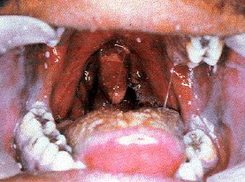
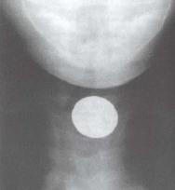
Oral Candidiasis
FB esophagus

Slide 17
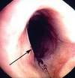
Schatzki’s ring
Esophageal web

Slide 18
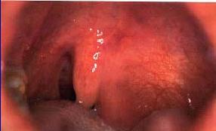
Parapharyngeal mass
Achalasia cardia

Slide 19
Normal Barium swallow

Slide 22
Thank you

