Slide 1
Rhinitis
Dr S Jaya Sandeep

Slide 2
CLASSIFICATION
Rhinitis
Chronic
Non Specific
Specific
Acute
Allergic

Slide 3
Acute inflammatory conditions
Acute Rhinitis or Coryza
Incubation period varies from 1 to 3 days and usually transmission occurs by droplet infection such as sneezing, coughing, talking or schooling years due to lack of resistance to infection.
Predisposing factors may be change of climate, temperature, humidity, poor nutrition, chronic sinusitis, fatigue, diabetes, tuberculosis and dysfunction of thyroid.

Slide 4
Etiology
Causative agents are the viruses such as rhinovirus, influenza and parainfluenza virus, syncytial virus, enteric cytopathogenic human orphan (ECHO) virus, coxsackie, adeno and reoviruses.
Secondary invading agents are Streptococcus, Moraxella catarrhalis, Haemophilus influenzae, Staphylococcus and pneumococci.
It spreads by kissing and through food, finger and fomites.

Slide 5
Pathology
Ischemia and vasoconstriction
Vasodilation
Edema
Increased activity of nasal glands and goblet cells
Leukocytosis and purulent discharge

Slide 6
Clinical features
1. Firstly, there is dryness and ticklish spot in the throat or nasopharynx.
2. sneezing, discharge from the nose and nasal obstruction.
3. Mucous membrane of nose and throat is swollen and congested.
4. Fever appears due to toxemia.
5. On 2nd or 3rd day, there is thick discharge, which is mucopurulent, nasal obstruction increases and on 5th day onwards, symptoms start decreasing and recovery occurs.

Slide 7
complications
Nasopharyngitis
Sinusitis
Eustachian tube (ET) catarrh
Otitis media
Lymphadenitis
Respiratory tract infection
Tonsillitis
Nephritis
Rheumatism

Slide 8
Management
Avoidance of dusty and crowded places
Complete isolation of patients
Balanced and nutritious diet
Sudden fatigue, change of temperature and humidity should be avoided
Proper sterilization of fomites is necessary
Role of cold (polyvalent) vaccine has not been proved.

Slide 9
Treatment
Complete bed rest
Hot water bath is quite helpful
There is role of vitamin C, 500 mg bid for 10 days
Antibiotics to prevent complications and secondary infection
Antihistaminics and anti-inflammatory drugs are given symptomatically 2 to 3 times a day
Smoking and hard drinks are avoided

Slide 10
Acute Nasal Diphtheria
Causative organism is Corynebacterium diphtheriae. It may be primary or secondary due to faucial diphtheria.
The patient presents with pyrexia, general toxemic features, lymphadenitis and palsies.
Treatment is with penicillin and antitoxin serum. Erythromycin is given in the patients with allergy to penicillin.

Slide 11
IRRITATIVE RHINITIS
Caused by exposure to dust, smoke or irritating gases such as ammonia, formaline, acid fumes, etc. or it may result from trauma inflicted on the nasal mucosa during intranasal manipulation, e.g. removal of a foreign body.
There is an immediate catarrhal reaction with sneezing, rhinorrhoea and nasal congestion.
The symptoms may pass off rapidly with removal of the offending agent or may persist for some days if nasal epithelium has been damaged.

Slide 12
CHRONIC NONSPECIFIC RHINITIS
Atrophic rhinitis
Chronic simple rhinitis
Chronic hypertrophic rhinitis
Rhinitis sicca
Rhinitis caseosa
Rhinitis medicamentosa

Slide 13
Atrophic Rhinitis
Atrophic rhinitis is a chronic inflammatory disease, which is characterized by progressive atrophy of mucous membrane of nose and turbinates.
There is also associated excessive crusting and abnormal patency of nasal passages
It is termed as ozena, if there is associated fetor
The disease usually starts at puberty, commonly seen in females.

Slide 14
types
1. Primary atrophic rhinitis type
2. Secondary atrophic rhinitis which may be due to
– Syphilis
– Tuberculosis
– Excessive surgery
– Chronic sinusitis
– Trauma
– Postradiation therapy

Slide 15
Causes
Heredity
Endocrinal
Racial
Nutrition
Immunocompromised
Autoimmune

Slide 16
Other Causes
Bacterial: Such as Coccobacillus foetidus, Bacillus mucosus, diphtheroid bacilli, Klebsiella ozaenae may be responsible for atrophic rhinitis
Empty nose syndrome: It is an iatrogenic condition caused by over enthusiastic removal of nasal turbinates during nasal surgery
Syphilis (tertiary)
Wide nasal cavity
Lupus, leprosy and tubercular
Extensive surgery on the nose
Chronic sinusitis.

Slide 17
Pathogenesis
There occurs metaplastic changes in columnar ciliated to cuboidal or stratified squamous epithelium
Capillaries are dilated and size and number of glands decrease
Periarteritis and endarteritis may be present
There may be atrophy of bones of the turbinate along with
atrophy of nerves
In type-I, endarteritis or periarteritis is present
In type-II, dilatation of capillaries is seen.

Slide 18
Clinical Features
Symptoms
It is a bilateral condition mostly in females present with:
• Nasal obstruction
• Nose bleed
• Headache
• Merciful anosmia—foul smell, which the patient herself is
unable to perceive due to atrophy of olfactory nerves and
excessive crusting of nose

Slide 19
Signs
• Grayish black crusts in the nose
• Nasal passages are roomy
• Turbinates are shrivelled and detachment of crusts leave a bleeding and ulcerated mucosa
• In late cases, septal perforation and saddle nose may be present
• Eustachian tube catarrh is present and paranasal sinuses and pharynx may be affected.

Slide 20
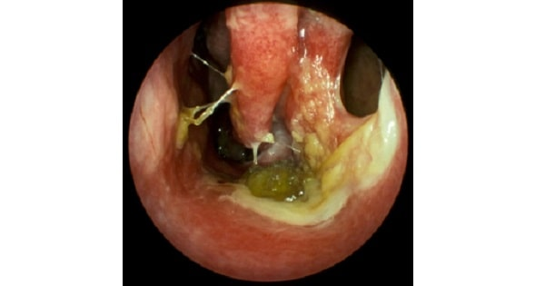
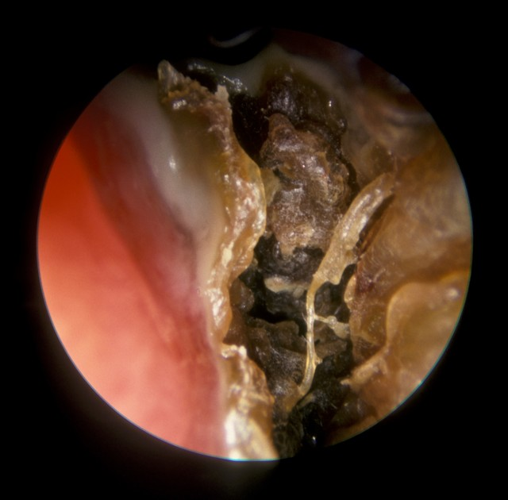

Slide 21
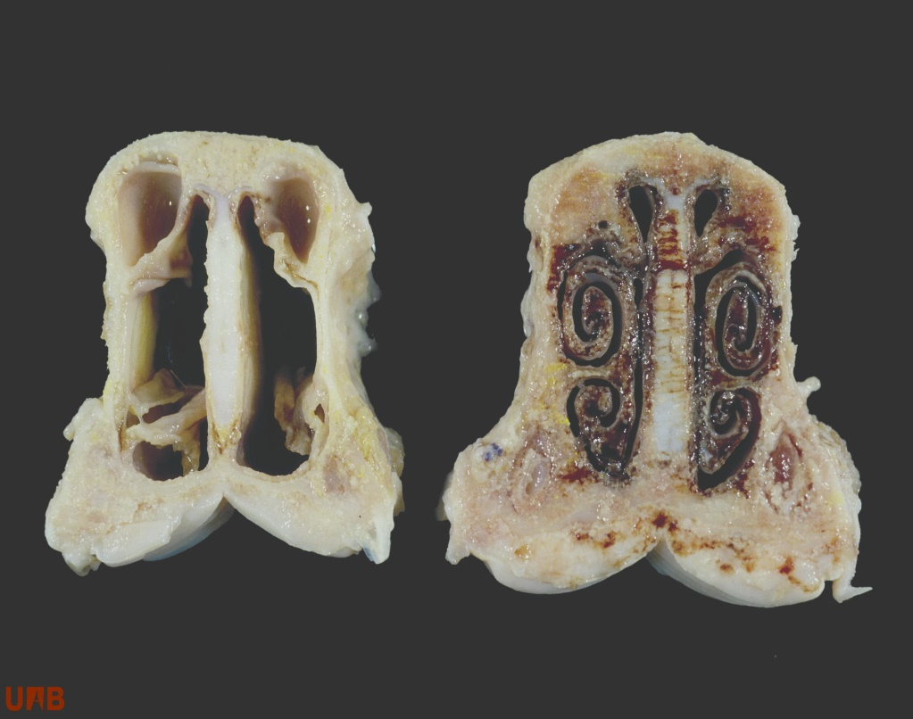
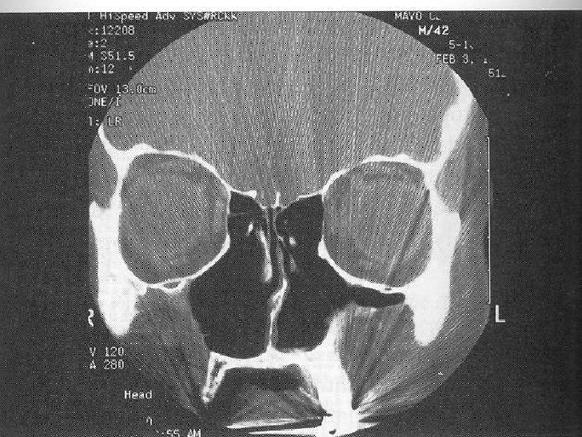

Slide 22
Treatment
Conservative
Regular nasal cleaning: By nasal douching with alkaline solution prepared by dissolving 280 ml of warm water in 28.4 gm of sodabiborate and 56.7 gm of sodium chloride.
Application of 25 percent glucose in glycerine, which inhibits the growth of proteolytic organisms, i.e. saprophytes
Estradiol in arachis oil for its vasodilation effect.
Antibiotic in antiozene solution—local application in the nose to control secondary infection.
Placental extract by submucosal injections.
High protein diet, Vitamin A

Slide 23
Surgical
Submucosal injection of paraffin or teflon paste in glycerine 50 percent decreases the nasal passages.
Young’s or modified Young’s operation
Folds of skin inside the nostril are raised and are sutured together with the object of complete interruption of air flow for a period of months to years. It helps by giving rest to nasal mucosa and by causing local hypoxia. In modified operation, partial interruption of the air flow is done

Slide 24
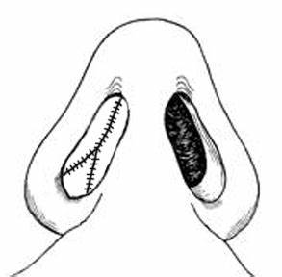
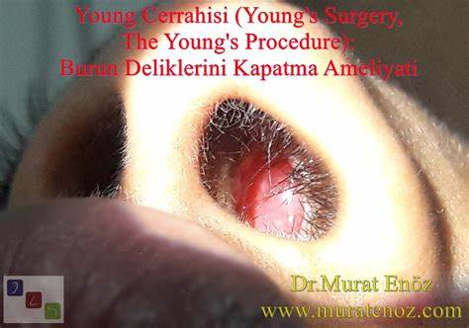

Slide 25
Eyries operation (1953): Placement of implants under the nasal mucosa to decrease the size of nasal cavity.
Insertion of fat and cartilage or Teflon strips have been inserted after lifting the flaps of mucoperiosteum on the septum or lateral wall.
Lautenslager operation is also done for atrophic rhinitis (medialization of lateral wall).

Slide 26
CHRONIC SIMPLE RHINITIS
Recurrent attacks of acute rhinitis in the presence of predisposing factors leads to chronicity
Persistence of nasal infection due to sinusitis, tonsillitis and adenoids
Chronic irritation from dust, smoke, cigarette smoking, sniff.
Nasal obstruction due to deviated nasal septum, synechia leading to persistence of discharge in the nose

Slide 27
Pathology
Simple chronic rhinitis is an early stage of hypertrophic rhinitis.
There is hyperaemia and oedema of mucous membrane with hypertrophy of seromucinous glands and increase in goblet cells. Blood sinusoids particularly those over the turbinates are distended.

Slide 28
Clinical features
Nasal obstruction
Nasal discharge
Headache
Swollen turbinates
Post nasal discharge

Slide 29
Treatment
Treat the underlying cause sinuses, tonsils, adenoids, allergy, personal habits (smoking or alcohol indulgence), environment or work situation (smoky or dusty surroundings).
Nasal irrigations with alkaline solution
Nasal decongestants
Antihistamines
Antibiotics

Slide 30
Chronic Hypertrophic Rhinitis
In this condition, there is hypertrophy of epithelial lining, glands,
and turbinates.
Important causes leading to this condition are
chronic infections of nose, PNS, chronic irritation of nose due to
smoke, fumes, dust or local use of drugs such as nasal drops.

Slide 31
Clinical features
Nasal obstruction, nasal discharge, anosmia and feeling of heaviness of head.
Examination shows thick mucosa with enlarged turbinate, which does not shrink with local drops.
Treatment
Size of turbinates can be reduced by electrocautery, submucosal
diathermy, partial resection of enlarged turbinates or by
use of laser

Slide 32
Compensatory Hypertrophic Rhinitis
This is seen in cases of marked deviation of septum to one side. The roomier side of the nose shows hypertrophy of inferior and middle turbinates.
This is an attempt on the part of nature to reduce the wide space to overcome the ill effects of drying and crusting that always attend wider nasal space.
Hypertrophic changes in these cases are not reversible with the correction of nasal septum and often require reduction of turbinates at the time of septal surgery.

Slide 33
Rhinitis Sicca
Rhinitis sicca is a milder form of atrophic rhinitis, which occurs in alcoholics, anemia, nutritional deficiencies and persons working in hot, dry and dusty occupation.
There is inactivity of seromucinous glands along with metaplasia of columnar ciliated epithelium to cuboidal or squamous epithelium.

Slide 34
Clinical Features
Irritation, dryness, crusting, bleeding some time in the anterior part of nose only, no fetor.
Examination shows a glazed mucosa with thin crusts.
Treatment
• Removal of the cause whatsoever
• Lubrication of the nose with vaseline
• Alkaline nasal douche, if required.

Slide 35
Rhinitis Caseosa
Rhinitis caseosa is also called nasal cholesteatoma
It is a chronic inflammatory condition with formation of granulations and presence of offensive cheesy material
It is seen more in males at any age group. It may be seen in chronic sinusitis infection due to streptothrix alba or the presence of a foreign body

Slide 36
Microscopically, it shows caseous debris with keratinous material, organisms and sometimes cholesterol crystals
Clinically, nose shows white debris, bone may be involved along with sinus infection.
Treatment
Thorough removal of caseous debris from nose by douching
or surgical means.

Slide 37
Rhinitis Medicamentosa
Rhinitis medicamentosa is seen more after prolong use of nasal drops and sprays which results in rebound phenomenon causing vasodilatation and engorgement of nasal mucosa.
On examination nasal mucosa is boggy and congested.
Treatment
a. Stop use of decongestants
b. Use of oral or topical steroids
c. Partial turbinectomy may be helpful

Slide 38
Thank you

